Slide 1
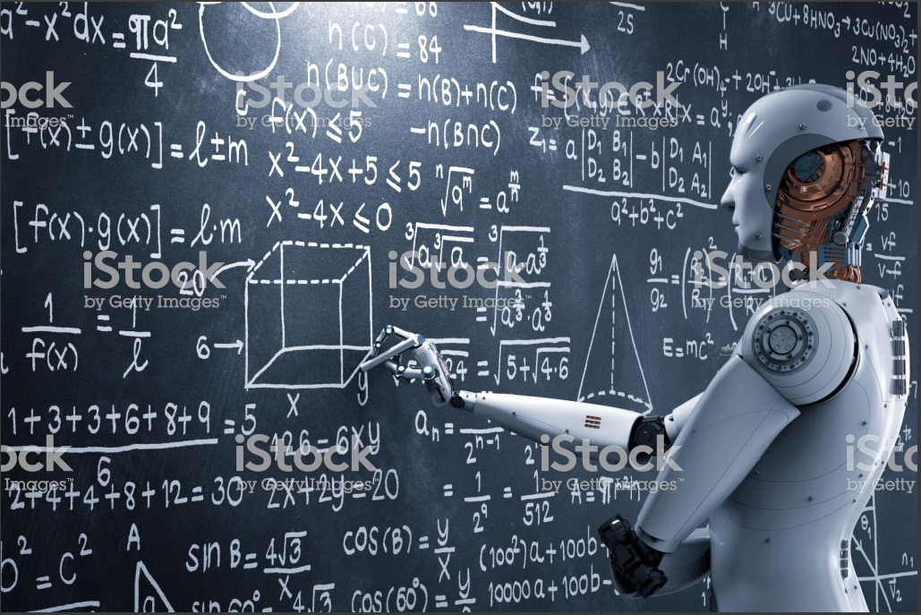
TRADING WITH
ARTIFICIAL INTELLIGENCE – AI

Slide 2
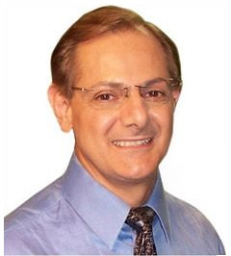
About the Speaker
Ed Barsano
CEO Saint Michael Technologies
Retired Microsoft software developer and manager
Creator of robotic, AI stock and crypto trading platforms
Ed Barsano Support@GoBabyTrade.com 480-370-8101

Slide 3
STANDARD DISCLAIMER
For demonstration purposes only. Saint Michael Technologies, LLC does not make buy, sell, or hold recommendations. Unique experiences and past performances do not guarantee future results. You should speak with your CPA or financial representative to ensure that the buying/selling of cryptocurrencies is suitable for your investment profile. All suggestions given hereto is intended for Simulation mode only.
The income projections, if any, or Strategy ideas, contained in this presentation are for illustration purposes only and are not warrantees by Saint Michael Technologies, its Associate or presenter in regards to how much you will earn or your particular level of success.
The expressed views, opinions and concepts of the presenters are just that, opinions. Interested parties should conduct their own due diligence prior to engaging in the services and / or strategies exhibited.
Saint Michael Technologies, its Associates, agents and employees do not provide legal or financial advice and do not provide any tax advice. Please consult your attorney or tax advisor.

Slide 4
you
ARTIFICIAL INTELLIGENCE TIMELINE
The term “Artificial Intelligence” was coined in 1956?
AI Boom: 1980’s
AI Explosion: 2020’s

Slide 5
What is AI?
AI stands for “Artificial Intelligence”
The study of computer algorithms that improve automatically through experience.
In other words, “SELF LEARNING SYSTEMS”

Slide 6
you
WHAT MAKES IT
SELF LEARNING?

Slide 7
s
How is AI Self Learning?
The answer is from studying millions of patterns (known inputs and known outputs)
Simplified Examples:
INPUTS | Known Output
1, 1 | 2
3, 5 | 8
2, 7 | 10
8, 3 | 11
3, 2 | ?
INPUTS | Known Output
1 , 1 | 1
3 , 5 | 14
2 , 7 | 14
8, 3 | 24
3, 2 | ?
Prediction accuracy increases as more patterns are analyzed

Slide 8
s
How is AI Self Learning?
Let’s apply that same model to the stock market.
29 Inputs | 0=bearish or false | 1=bullish or true
INPUTS | Known Output
1, 1, 1, 0, 1… | Up Ticked
1, 0, 1, 1, 1… | Up Ticked
1, 0, 0, 0, 1… | Down Ticked
0, 1, 1, 1, 1… | Up Ticked
1, 1, 0, 0, 1… | Down Ticked

Slide 9
Video: AI Forecasting Example
Example: GoBabyTrade system will only acknowledge a Buy or Sell If the AI returns a 95% or higher result

Slide 10
you
What are some AI applications?
ChatGPT: Chat
DALL-E2: Create realistic images
Whisper: Transcribe to English
OpenAI API: Integrate into your app
OpenAI Platform: Development Platform

Slide 11
you
The best way for an investor to use AI is as a tool to support or implement a trading strategy

Slide 12
you
How is AI used with stock trading?
Identify active moving stocks
Identify stocks in todays newsfeeds
Identify stocks making new highs/lows
Identify stocks breaking out price ranges
Filter stocks on a variety of tech indicators
More…

Slide 13
you
What to trade
When to open a position
When to add to a position
When to close a position
How much to invest per trade
(Money Management)

Slide 14
you
BEWARE OF FALSE
AI CLAIMS

Slide 15
Just putting “AI” in a company or product name does not mean “AI” is being used.

Slide 16
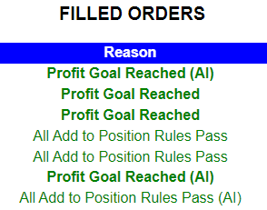
AI Usage Displayed
Shows (AI) if AI played any part in the trade decision

Slide 17
you
AI is NOT a crystal ball
How much does AI predict Bitcoin will go up
Tomorrow?
next week?
next month?

Slide 18
AI is NOT a crystal ball
Results are only as good as the input and output
Data provided to the AI system
Request “Salmon” (swimming in stream) (OpenAI)

Slide 19
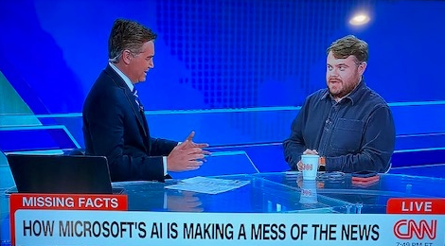
AI Can Be Tricked
Lots of bad data yields bad results

Slide 20
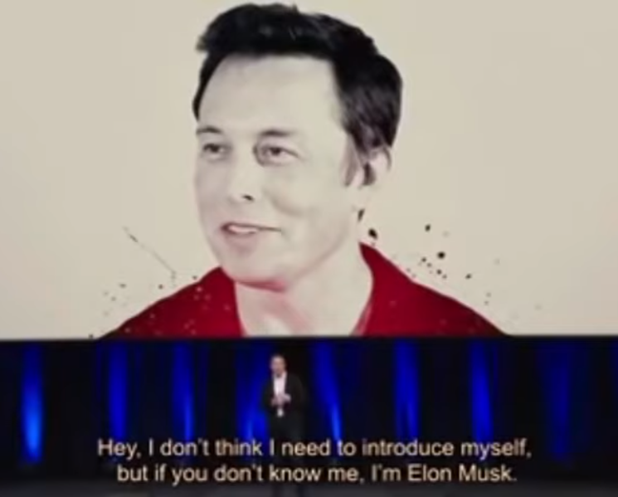
F
“AI” is being used by scammers
Quantum AI
False videos that show billionaire Elon Musk promoting a financial venture called Quantum AI use doctored footage and artificially generated audio to induce Facebook users to send money to scammers.
RMIT University

Slide 21
Some Known Companies Utilizing AI (Pattern Analysis)
McDonalds - Traffic Pattern Analysis (for optimal restaurant locations)
Apple - Voice Analysis (Siri)
Tesla/Ford/Volkswagen - Self Driving Cars (Still years out!)
GoBabyTrade – Fully Robotic/AI Stock & Crypto Web Trader

Slide 22
Q & A

Slide 23
Thank You
Ed Barsano Support@GoBabyTrade.com 480-370-8101

