Slide 1
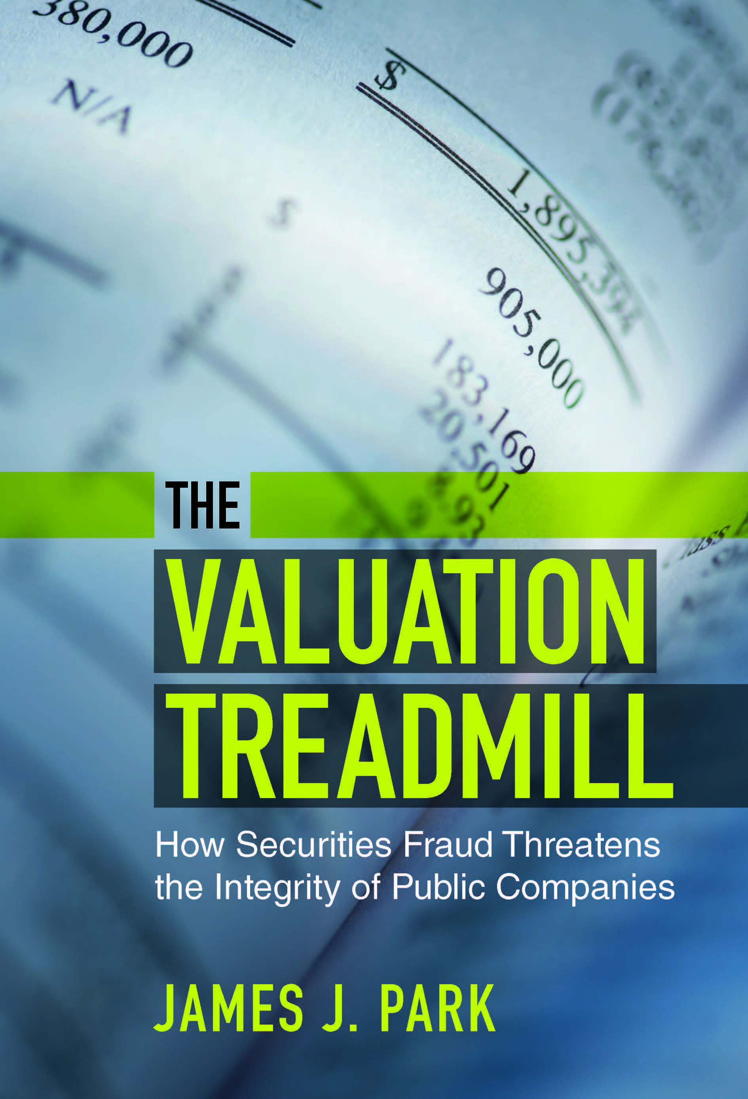

Slide 2
Elements of a Rule 10b-5 Securities Fraud Claim
Misrepresentation by the Corporation
that is Material to Investors
made with Fraudulent Intent
Causes
Losses

Slide 4
Why do companies commit fraud?
Create the impression of strong growth
Hide evidence of a decline in the company’s business

Slide 5
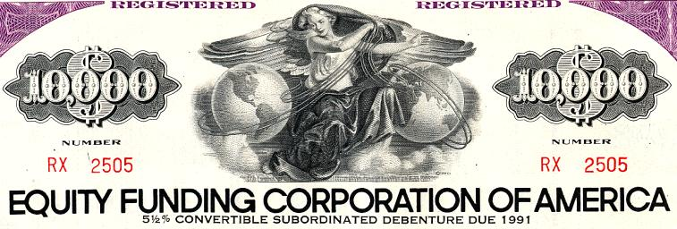
Pressure to Increase Earnings

Slide 6
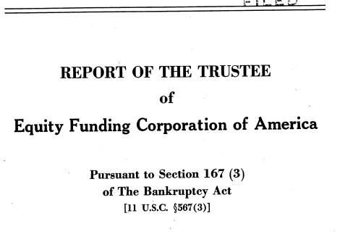
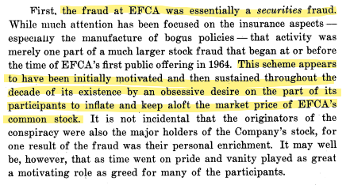
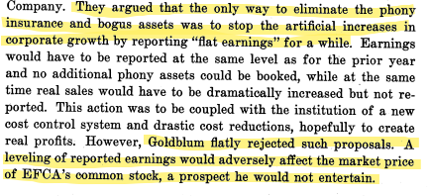

Slide 7
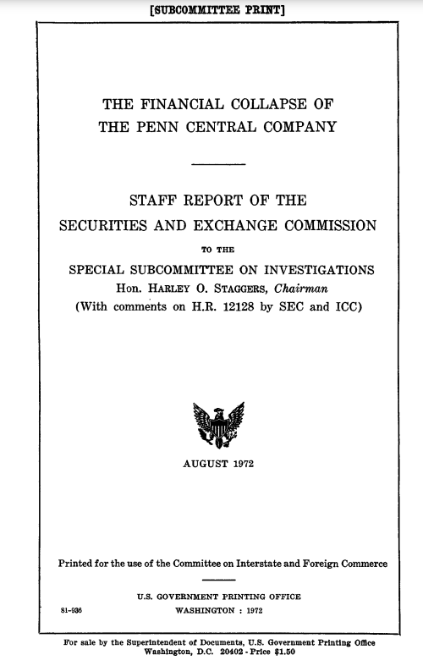
Pressure to Hide Decline

Slide 8
Six Flags Transaction
Penn Central sold Six Flags amusement park to a partnership for $29 million
Penn Central agreed to retain the risk of losses on the amusement park
Similar problem as the sale of assets to Special Purpose Vehicles by Enron

Slide 9
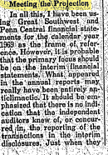
Why was the transaction material?
Without the transaction, Penn Central would have reported a loss in a quarter when it had predicted a “favorable showing”

Slide 10
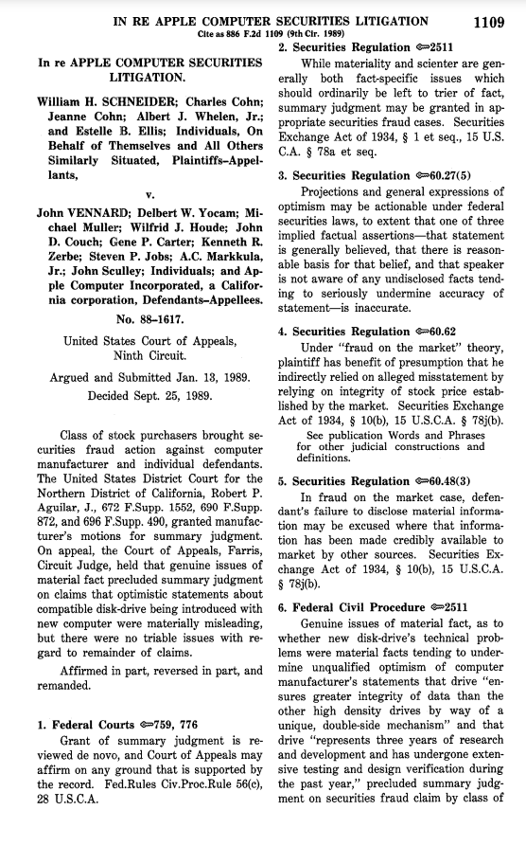
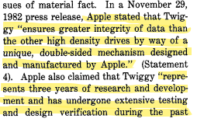
Pressure to Show Progress on a Product

Slide 11
Did Apple Know the Twiggy was a Failure?
Two weeks before the press release, a memo warned: “[a]s of now, the Twiggy reliability would LEAD US TO DELAY THE INTRODUCTION OF LISA BY MANY MONTHS.”
A week after the press release, Steve Jobs said he had “virtually no confidence” in the division responsible for the Twiggy

Slide 12
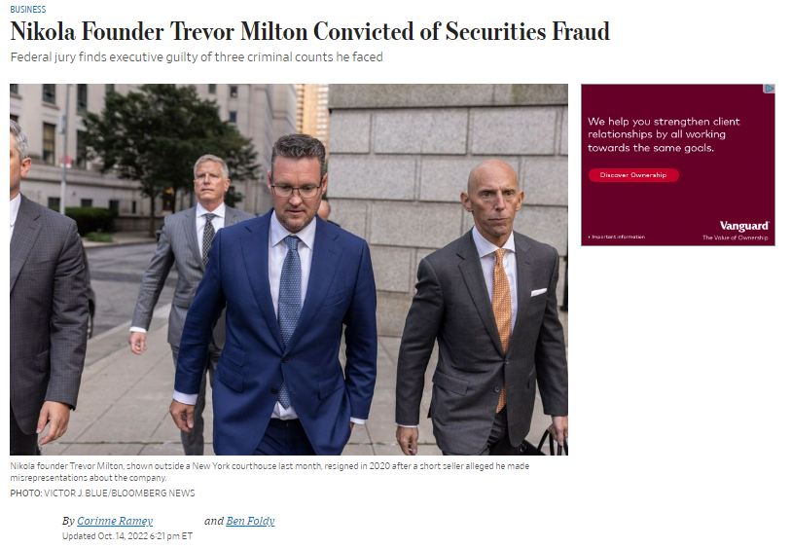

Slide 13
Trevor Milton’s Misstatements
Claimed Nikola had a “fully functioning” semi-truck prototype
Claimed Nikola had built a electric- and hydrogen- powered pickup from the “ground up”
Claimed that Nikola was producing hydrogen at reduced cost
Claimed that Nikola had developed batteries in-house
Claimed Nikola had billions of dollars in firm orders for its trucks

Slide 15
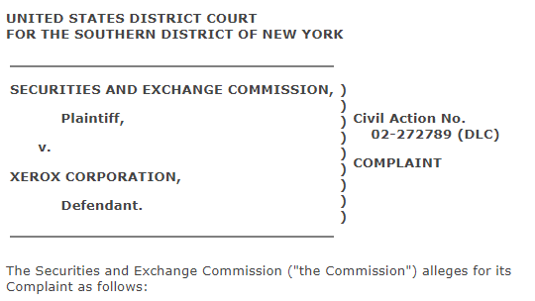
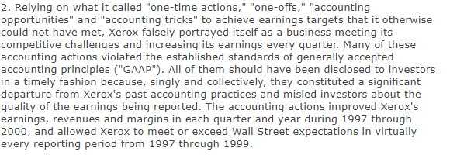
Pressure to Meet Quarterly Projections

Slide 17
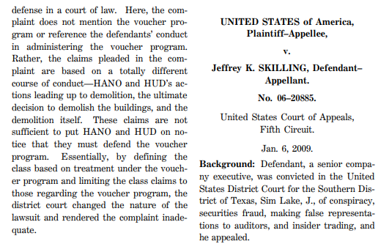
Was Enron a Criminal Case?

Slide 18
The Prosecutors focused on relatively small misstatements
Skilling’s misstatements – impact on earnings
Segment reporting violation - $500 million
Reserves manipulation - $7 million
LJM transaction (Cuaiba) - $65 million
Nigerian barges sale - $12 million
Raptors - $500 million

Slide 19
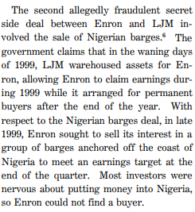
Why did Enron sell Nigerian barges?

Slide 20
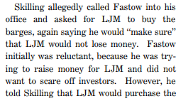
Why was this sale fraud by Skilling?

Slide 21
Internal Controls as a Response to Securities Fraud
Public Company Accounting Oversight Board, Auditing Standard No. 5: Internal controls should scrutinize:
(1) “significant, unusual transactions, particularly those that result in late or unusual journal entries”;
(2) “journal entries and adjustments made in the period-end financial reporting process”;
(3) “related party transactions”;
(4) “significant management estimates” and
(5) “incentives for, and pressures on, management to falsify or inappropriately manage financial results.”

Slide 22
What motivates securities fraud?
Unreasonably high market expectations
Need to convey predictability
Win at all costs corporate culture
Deference to a successful and charismatic founder
Excessive stock compensation

Slide 23
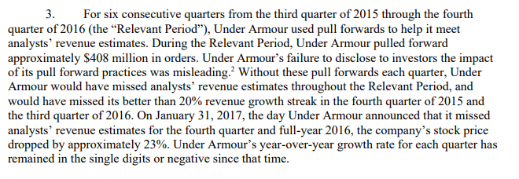
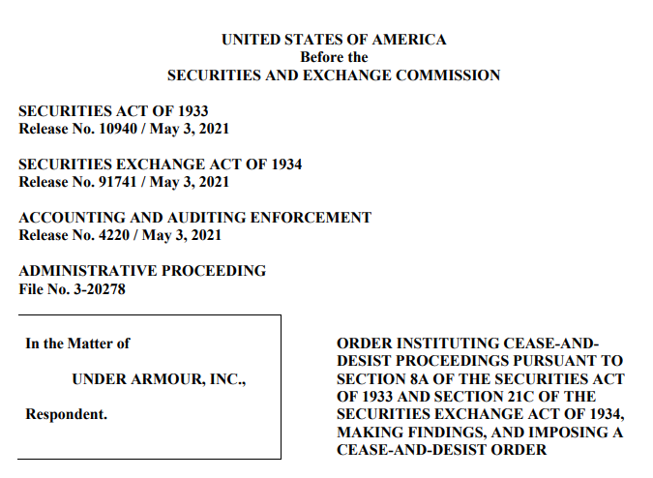
Real Earnings Management

Slide 24
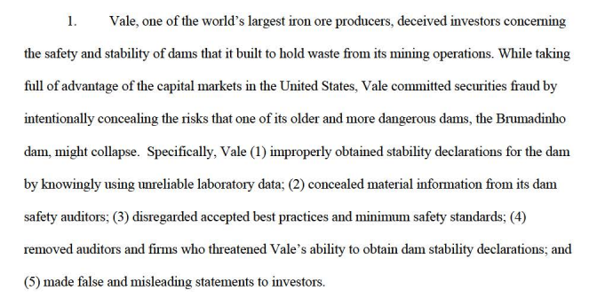
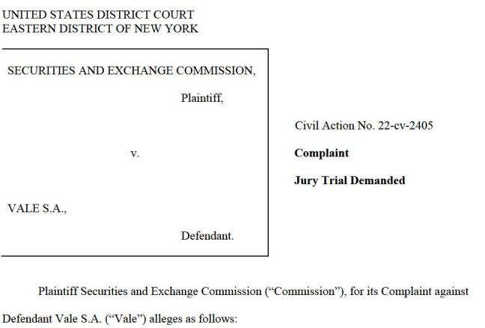
The Future of Securities Fraud: ESG

Slide 25
ESG Securities Fraud - Boeing

Slide 26
One of Boeing’s Misleading Statements

Slide 27
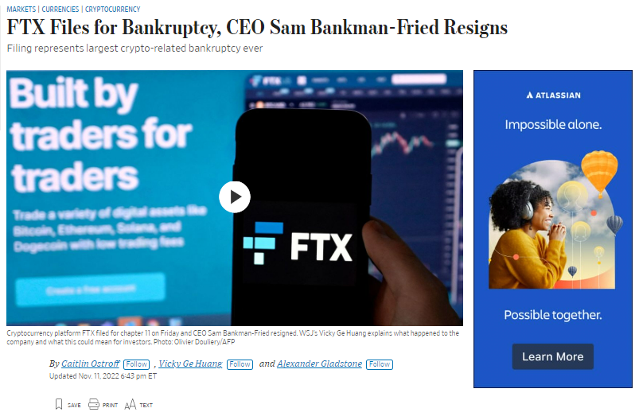

Slide 28
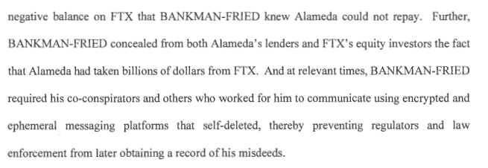

Slide 29
Misrepresentations
FTX has a focus on “consumer protection” and had “principles for ensuring investor protections on digital asset-platforms” such as “avoiding or managing conflicts of interest”
FTX “segregates consumer assets from its own assets across our platforms”

Slide 30
Commingling – FTX and Alameda
FTX did not have a separate bank account where customer funds were deposited
Alameda had access to the bank account where FTX funds were deposited and withdrew funds
Alameda was permitted to have a negative balance in its FTX trading account
Sam Bankman-Fried directed personnel to change computer code to permit this

