Slide 1
AAII’s Model Shadow Stock Portfolio: Putting Theory Into Practice
Wayne A. Thorp, CFA
Senior Financial Analyst
Head of Research & Analysis
AAII
wayne@aaii.com
Notes:
Welcome everyone and thank you for attending today’s session. For the next hour or so I will be talking about active investing in a stock portfolio, specifically AAII’s Model Shadow Stock Portfolio. This portfolio, in my opinion, perfectly encapsulates AAII’s mission of providing evidence-based, practical, real-world application of classic academic research that not only can individual investors participate in, but where they can thrive and have the advantage over professional money managers.

Slide 2
Presentation Overview
Model Shadow Stock Portfolio Buy & Sell Rules
Portfolio Management Guidelines
AAII Tools & Resources
Underlying Academic Research
Notes:
I will be talking today about the academic research that gave birth to the Shadow Stock portfolio as well as the buy and sell criteria, portfolio creation and portfolio management rules and how they evolved over the last 30 years
I will also talk with you about how individuals like you can get started with their own portfolio of Shadow Stocks
And, lastly, as time permits, I will cover some of the resources AAII provides to help its members create and monitor their Shadow Stock portfolio
I don’t mind taking questions are we go along, so feel free to raise your hand. If I see we are getting a little bogged down with questions, I will ask that we hold them off until the end.

Slide 3
Model Shadow Stock Portfolio
Sound Academic Research
Practical Selection & Trading Rules
Notes:
The Model Shadow Stock Portfolio came about as an attempt to codify persuasive academic theories into a set of straightforward, practical selection and trading rules that an individual investor could follow with minimal effort
The portfolio has allowed us to share the problems and procedures of managing a portfolio of small stocks using a quantitative approach

Slide 4
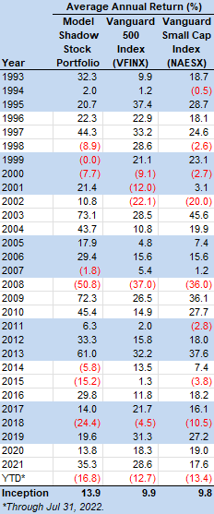
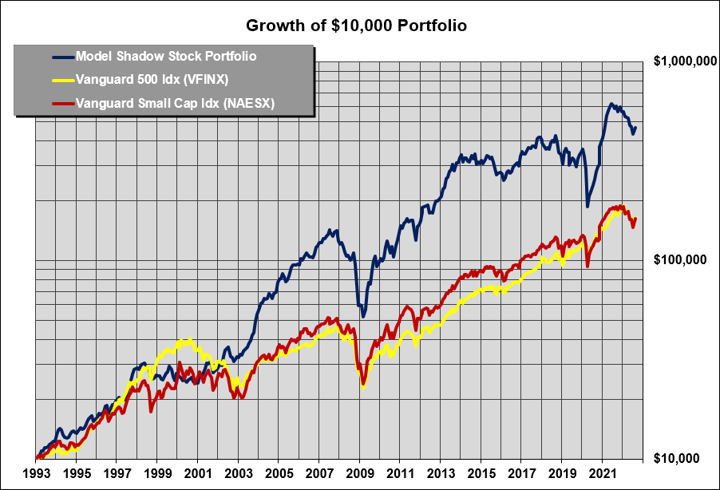
Notes:
This chart illustrates the performance of the Shadow Stock portfolio since its inception in 1993
This is a REAL WORLD, REAL MONEY portfolio, so this performance reflects transactions costs
Dividends are kept in cash and invested in new positions, not reinvested
The Shadow Stock Portfolio, on average has outperformed the S&P 500 by 600 basis points a year for nearly 30 years
This chart also shows that micro-cap value goes on runs where it will outperform large-cap stocks and then suffer streaks of underperformance
Serial correlation of returns: describes the extent to which the return in one period is related to the return in the next period
Small-cap value lagged large-cap growth during the tech bubble of the last 1990s
It then went on a strong run to start the new century
It suffered back-to-back losing years in 2007 and 2008 as well as 2014 and 2015.
Lagging large-caps this year as there has been a “flight to safety” amid worries about the economy
If you believe in an investment strategy or approach, you have to be willing to weather the periods of underperformance in order to enjoy the periods of outperformance
While I can’t say for sure that the Shadow Stock Portfolio will end up outperforming the S&P 500 this year or next year, I feel fairly certain that it will continue to outperform in the long run

Slide 5
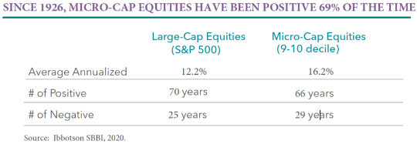
Large-Cap vs. Micro-Cap
Perritt Capital Management
Notes:
Between 1926 and the end of 2020, micro-cap stocks, on average, have outperformed large-cap stocks by 6-percentage points
This means micro-caps double-up on large-caps roughly every 12 years
This is despite the fact that large-caps have posted more “up” years than micro-caps and, thus, fewer “down” years than micro-caps

Slide 6
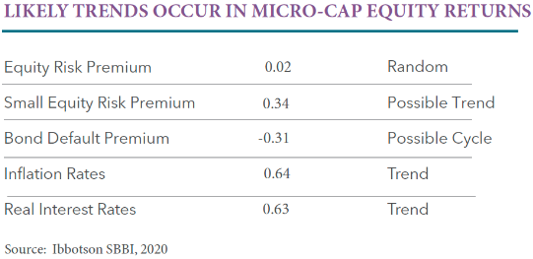
Trends in Micro-Cap Stocks
Perritt Capital Management
Notes:
However, micro-caps have shown that they tend to go on runs
This is indicated by the serial correlation of returns in micro-cap stocks
The higher the serial correlation, the more likely the trend in one year will continue to the next
Among several measurable data sets, the small equity risk premia, inflation rates and real interest rates have shown that they tend to follow trends

Slide 7
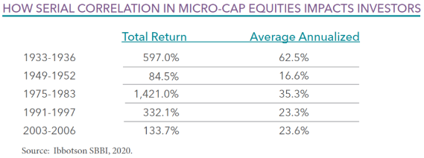
Trends in Micro-Cap Stocks
Notes:
These trends are reflected in the data in this slide
Micro-cap stocks are much more likely to go on a winning streak than a losing streak
Since 1926, micro-cap stocks have seen 19 instances of positive returns lasting at least 2 years in a row versus only 5 instances were they posted losses in two consecutive years
Down years are more apt to be single-year events
The strength of micro-caps since 1926 has been driven by strong returns in those strings on consecutive up years
Between 1975 and 1983, micro-caps returned over 1,420% for an average annual return of 35.3%
Most recently, between 2003 and 2006, the total return in micro-cap stocks was 133.7% or nearly 24% a year

Slide 8
Primary Size Consideration: Market Capitalization
Notes:
One critical factor for selecting Shadow Stocks is market capitalization: Market Cap is price per share times the number of shares outstanding
Common measure of company size
Represents the market’s view of the net worth of a firm

Slide 9
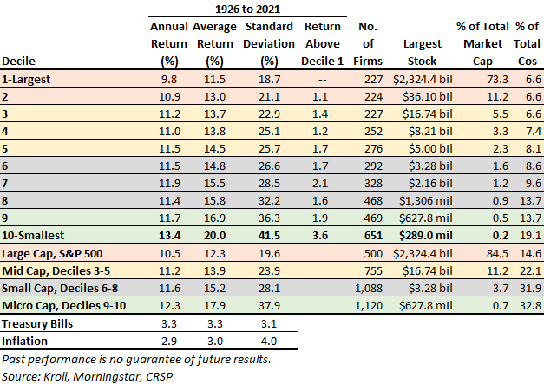
Performance by Market Cap
Notes:
There is a large body of research that indicates that smaller stocks, in the long run, outperform larger stocks, even adjusted for risk
This chart breaks exchange-listed stocks into deciles based on the market cap distribution of NYSE stocks
The market cap decile with the most companies 10th decile, the micro-caps
This is the realm where individual, retail investors have the advantage
Supported by academic research
Institutional money cannot buy these stocks in sufficient volume without having a meaningful impact on the share price
Here, opportunities exist for individual investors to find neglected, mispriced stocks
The largest stock in the 10th decile as of September 30, 2016, was Pioneer Energy Services Corp at $262.9 million (it’s now around $145 million)

Slide 10
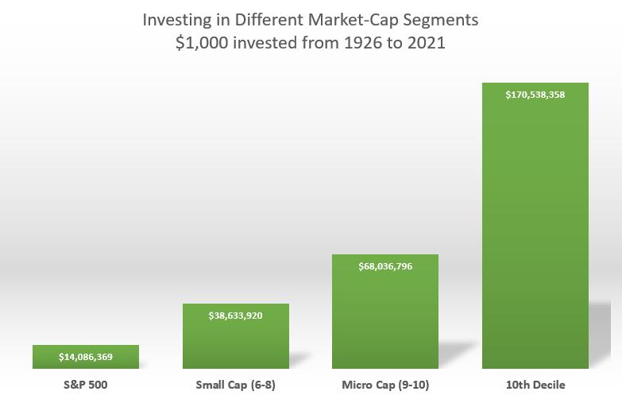
Notes:
This slide shown how much you would have made by investing $1,000 in the various market cap segments between 1926 and the end of 2021
The 10th decile, which is where the Shadow Stocks live, outperformed the S&P 500 by over 1,100% during that period

Slide 11
Invest Where YOU Have the Advantage
Notes:
In general, the average individual investor is overmatched by professional investors when it comes to investing in the most widely-followed stocks
However, the realm of micro-caps offers us a unique opportunity where the big money cannot venture
Individuals can take positions in micro-cap stocks without distorting the price
Individuals can invest in thousands of micro-cap stocks that mutual funds and other institutions cannot touch
Individuals can time buying and selling to match their tax situation and produce a higher after-tax return, which isn’t the case when investing in mutual funds or ETFs

Slide 12
Primary Size Consideration: Market Capitalization
Market Cap <= $350 million
Lowest 10% of NYSE-listed stocks
Current cutoff established in September 2022
Original cutoff: $55 million in 1993
Highest cutoff: $500 million between June 2021 and February 2022
Notes:
The Shadow Stock portfolio invests only in those stocks that make up the roughly lowest 10% in market cap based on the lowest market cap decile among NYSE stocks
Currently, a stock cannot have a market cap greater than $400 million to be considered as a Shadow Stock
This ceiling has risen from $55 million at the portfolio’s inception in 1993
The criteria we use are not static; they adjust to market conditions
We lowered the ceiling in March $400 million from $500 million

Slide 13
Secondary Size Consideration: Liquidity
Market Cap >= $30 million
Current minimum set in December 2013
Original minimum of $10 million in 1993
No OTC stocks (bulletin board or pink sheets)
Share price > $4
Use limit orders to control buy/sell prices
Average daily trading volume >= 10x position you are seeking
Notes:
Liquidity is a legitimate concern since many stocks with such low market caps do not trade actively
Any significant money flowing in or out of these stocks will probably impact the price
- Only interested in stocks that have an adequate market for us to take a position
- Also try to avoid stocks in danger of being delisted
- Currently buy stocks with a minimum market cap of $30 million
- Original minimum of $10 million in 1993
- Current minimum of $30 million since December 2013
No OTC stocks (bulletin board or pink sheets)
You also want to invest in stocks with sufficient liquidity to allow you to enter or exit positions in a timely manner without having a significant impact on the share price

Slide 14
Primary Value Consideration: Price-to-Book-Value Ratio
Notes:
Another primary selection factor for the Shadow Stock Portfolio is book value
Book Value = Assets – Liabilities
Also called shareholder’s equity
Price-to-Book-Value: Relates market’s assessment of company’s net worth to accounting measure of company’s net worth
A comparison of the market value of a firm to the accounting value of a firm
Financial structures of all industries not comparable; most studies with book value exclude financial stocks
Shadow Stock Portfolio excludes financial sector
Book value based on historical accounting measures
Items of real and substantial value may not appear on the balance sheet (i.e., customer loyalty, copyrights, patents, etc.)
Historical, depreciated value of items carried on book may not reflect the current market value or replacement value
Price-to-book-value ratio works because, on average over a number of companies and a number of years, accounting book value is a “close-enough” estimate of economic value
Over the long term, the lower the price-to-book ratio, the higher the return

Slide 15
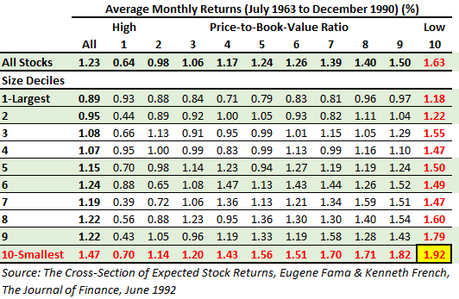
Primary Value Consideration: Price-to-Book-Value Ratio
Notes:
This data is from a landmark study by Eugene Fama and Kenneth French that was the catalyst for Jim Cloonan, AAII’s founder, creating the Shadow Stock Portfolio
The Fama-French study showed that price-to-book was the best, most predictive valuation measure
They also found P/B to be less volatile than the price-earnings or PE ratio
Also, you cannot calculate a trailing P/E if earnings are negative
Much less common for a company to have negative book value
Fama & French confirmed that the smallest firms had the best returns
However, combining the lowest market cap stocks AND those stocks with the lowest P/B yielded the best results over the study period
Even on a risk-adjusted basis
Shadow Stocks lay at the intersection of the lowest 10% in terms of P/B and the lowest 10% of market cap
Here is where only individual can invest and outshine institutional investors

Slide 16
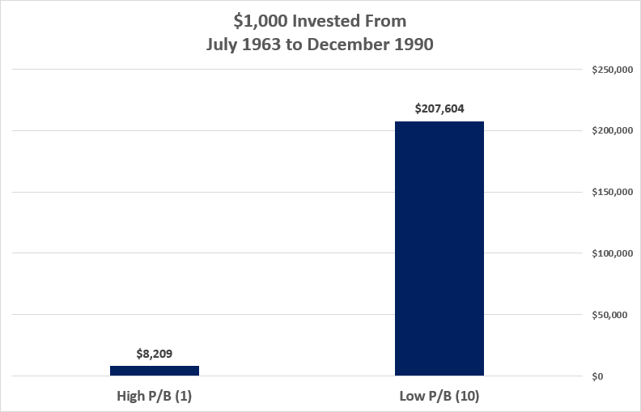
Notes:
This slide shows the difference in returns between investing in the highest price-to-book stocks and the lowest price-to-book stocks between July 1963 and December 1990
Investing in the lowest P/B stocks outperformed the highest P/B stocks by nearly 2,430%

Slide 17
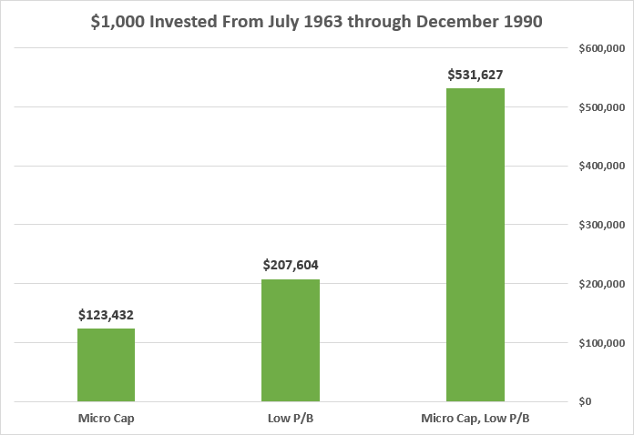
Notes:
This slide shows the difference in returns between investing in the highest price-to-book stocks and the lowest price-to-book stocks between July 1963 and December 1990

Slide 18
Primary Value Consideration: Price-to-Book-Value Ratio
Notes:
The data assume dividend reinvestment & exclude transaction costs
The top two performer over the period were small- and large-value
Small-value does carry with it greater volatility as measured by standard deviation
However, you are being rewarded for this higher risk with higher returns
The 2010s was the only decade that small-value was the weakest of these four segments
Over the 10-year period ended December 31, 2021, is still the weakest performer among these four segments
Academic studies have shown that the market overreacts to bad news and underreacts to good news
Therefore, there may be more room for value stocks, which are more likely to have reported bad news, to improve and outperform growth stocks, which have high expectations built into them

Slide 19
Primary Value Consideration: Price-to-Book-Value Ratio
Price-to-book-value ratio <= 0.9
Bottom 10% of NYSE stocks
Current maximum set in March 2022
Original cutoff of 0.61 in 1993
Lowest cutoff of 0.60 between August 2001 & October 2003
Highest cutoff of 1.10 between June 2021 and February 2022
S&P 500 P/B currently 3.93 (multpl.com, 8/31/2022)
Year Ago 4.38 (multpl.com, 9/30/2021)
Primary ranking variable
Notes:
- Buy stocks with price-to-book-value ratio in the bottom 10%
- Currently, maximum P/B is 0.9, which we lowered from 1.1 in March of this year
- Original cut-off of 0.61 in 1993
- Lowest cut-off of 0.60 from August 2000 to October 2003
Highest cut-off of 1.1 from June 2021 to February 2022
Again, the criteria adjust with the market
- S&P 500 P/B:
- Currently: 3.93; Year Ago: 4.38
P/B is also the primary ranking variable
Buy those stocks with the lowest valuation and adequate liquidity
- Attempt to construct portfolio of stocks that are both lowest 10% in size (market cap) and lowest 10% in value (price-to-book-value ratio)

Slide 20
Momentum Tie-Breaker: Relative Price Strength
“Of all the potential embarrassments to market efficiency, momentum is the primary one.”
—Eugene Fama
“Growth and value investing are joined at the hip.”
—Warren Buffett
Notes:
For value investors, the sweet spot in investing is being able to buy an undervalued stock right before its true value is recognized by the market and just before its stock price begins to take off
We can do this by identifying stocks with good value prospects that are just starting to exhibit good momentum characteristics
Combining value and momentum attempts to help us avoid:
Value traps—stocks whose price continues to fall; these so-called “falling knives”
Trying to avoid stocks whose value will never be recognized by the market
Underperformance due to the opportunity cost associated with holding a stock with great potential, but whose value takes an inordinate amount of time to be recognized by the market
Stocks can stay undervalued (or overvalued) for decades
Using momentum is equally important for what is it eliminating from consideration
It takes buying in a stock based on its undervalued state for it to converge to its intrinsic value
Momentum identifies stocks being bought by investors
When trying to decide between multiple Shadow Stock candidates, four-week relative price strength is used
Notable study from Asness, Moskowitz and Pederson “Value and Momentum Everywhere”
Value and momentum strategies work well together
They found that combining value and momentum strategies resulted in significantly higher risk-adjusted returns

Slide 21
Momentum Consideration: Relative Price Strength
Relative Strength 4-week used as a tie breaker to narrow down passing companies, if needed
Notes:
We do not use price momentum as a selection criteria
Instead, we use it as a tie-breaker between stocks with similar price-to-book-value per share ratios

Slide 22
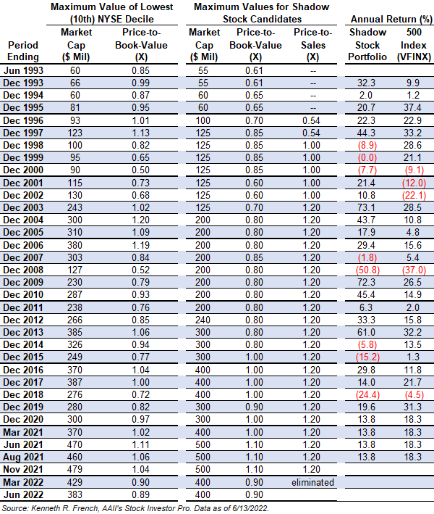
Levels of Key Factors Over Time
Notes:
This table shows how valued have changed over time for all the Shadow Stock selection factors
Gives you an idea of how the factors have changed over various bull and bear segments of the market
However, these factors are not trying to time the market, a strategy I do not believe in, nor does it work on a long-term basis

Slide 23
Shadow Stock Financial Considerations
Trailing 12m EPS from continuing operations > $0
When available, consensus estimates must also be positive for current quarter and year
Avoid any stock that was sold from the portfolio in the last two years
Notes:
Another reason why Jim created the Shadow Stock Portfolio was to highlight the unique challenges of building and maintaining a portfolio of micro-cap value stocks
One issue he ran into early in the portfolio’s life was companies passing the screen and then falling off month-to-month
This constant buy and selling increased the transactions costs of the portfolio
To lower the turnover of the portfolio, as well as identify more financially-strong companies, minimum financial considerations were also added to the selection criteria
Positive earnings from continuing operations over the last quarter and trailing 12 months (last 4 quarters)
Also, if a stock is tracked by an analysts, the consensus estimate for the current fiscal quarter and year must be positive
Also, avoid any stock that was sold from the portfolio in the last two years
Avoid marginal stocks that are forever marginal, creating high transaction costs

Slide 24
Shadow Stock Financial Considerations
Avoid stocks not listed on U.S. exchanges and Chinese firms
Avoid financial stocks, leasing & rental companies, real estate investment trusts (REITs) & limited partnerships, etc.
Avoid companies that have not filed a quarterly SEC report (10-Q) in last six months
Notes:
- Avoid foreign stocks
- Potential for different accounting procedures
- Withholding taxes on dividends
- Avoid financial stocks and limited partnerships
- High levels of acceptable liabilities make it difficult to make meaningful comparisons of popular ratios
- Avoid company’s that have not filed a quarterly SEC report (10-Q) in last six months

Slide 25
Building Your Shadow Stock Portfolio: Placing Trades
Average daily trading volume > 10x number of shares you want to buy
You may need to slowly move in & out of positions
Be willing to build positions slowly by placing partial orders
Notes:
- Exercise care if the average daily volume is not 10x the amount needed for your position
- It will be difficult (costly) to build or sell position
- You may need to slowly move in & out of position
- If necessary, build a position gradually. With low commissions, it is often better to place partial orders than to try to establish a large position all at once

Slide 26
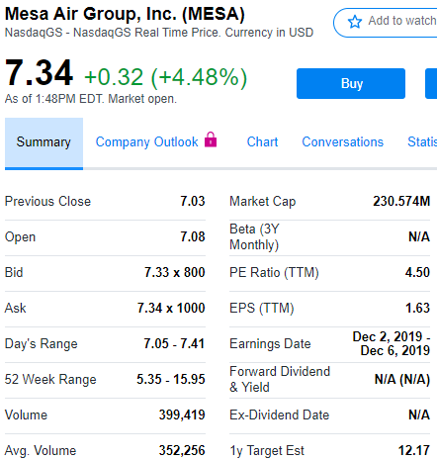
Building Your Shadow Stock Portfolio: Placing Trades
Avg. Daily Volume: 352,256
$5,000 ÷ $7.34 = ~680 shares × 10 = 6,800 minimum daily volume
352,256 ÷ 10 = ~35,200 shares maximum supported position
35,200 × $7.34 = $258,368 maximum dollar position

Slide 27
Building Your Shadow Stock Portfolio: Placing Trades
Cancel open orders if price move pushes price-to-book ratio or market cap beyond buy limits
Keep shares you already have

Slide 28
Use Limit Orders for Buy & Sell Trades
Bid/ask spread > 2%: Place limit orders between the bid and ask price to keep the transaction cost low
Bid/ask spread < 2%: Place limit orders at the ask for a buy and at the bid for sell

Slide 29
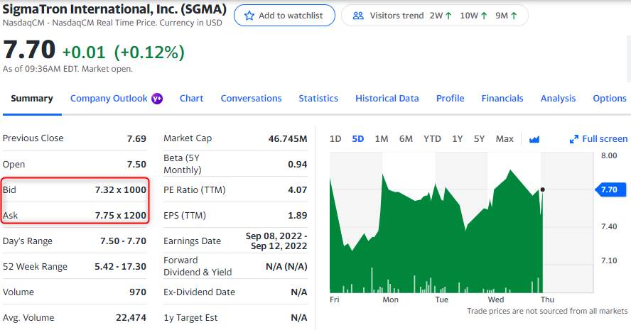
Bid-Ask Spreads
Bid-ask spread: (ask – bid) ÷ ask
($7.75 – $7.32) ÷ $7.75
= 0.5548 or 5.55% → Place limit order ~$7.54
Notes:
Bid/ask spread > 2%: Place limit orders between the bid and ask price to keep the transaction cost low
Bid/ask spread < 2%: Place limit orders at the ask for a buy and at the bid for sell

Slide 30
Use Limit Orders for Buy & Sell Trades
Nasdaq: Use day orders that expire at end of day if not filled
NYSE & Amex: Use good-til-canceled orders to keep your place in the specialist book
Adjust limit price if market is not close to desired price after a few days

Slide 31
Portfolio Construction
Use online discount broker to keep trading fees low
10-stock portfolio minimum number of holdings
$25,000 minimum investment
15 to 20 stocks: $100,000 to $1 million
25+ stocks: Over $1 million
Invest equal dollar amounts in each security
Notes:
Much like Lay’s Potato Chips, you can’t have just one Shadow Stock
The market does not reward you for the excess risk you incur for only buying 1 stock
Tracking the portfolio month in and month out, it is not uncommon to see one of two stocks drop over 20% in a month, as well as stocks that rise more than 20%
Need a sufficient number of stocks to protect you from the big losers and, hopefully, capture some of the big winners
10-stock portfolio: minimum number of holdings
15 to 20 stocks: $100,0000 to $1 million
25+ stocks: Over $1 million
Invest in roughly equal dollar amounts in each security
If building a portfolio slowly by adding stocks over time, try to establish positions that will represent desired portfolio percentage
It is also important to monitor your trading costs
Can quietly eat away your returns over time
# stocks x commission x 2 (roundtrip) = total commissions
Dividend this by total amount you are looking to invest to arrive at the expense ratio

Slide 32
Knowing When to Sell
Notes:
- Sell process just as important as buy process
- Investors tend to sell winning positions too quickly & hold onto losing positions for too long
- Investors hate to give up some of the gain from a winner and would rather lock in a small profit than hold on for larger gain, but risk giving up some of the profit
- Investors like to hold onto losing positions to try and break even
-The Shadow Stock Portfolio is a complete investment system, with explicit criteria for both buying AND selling

Slide 33
Rules to Overcome Emotion
Notes:
One of the many reasons why I love quantitative investing is because the rules we establish to buy and sell stocks help us overcome emotions, especially during volatile market times
Rules help to overcome emotions
Sell when stock is no longer attractive and better opportunities are available
Consider rebalancing when positions put portfolio way out of balance
Shadow Stock Portfolio sell rules (value & size) normally keep positions from getting too large for very long

Slide 34
Shadow Stock Portfolio Sell Rules
Price-to-book-value ratio > 3x current buy factor
3 × 0.9 = 2.7
Sell if there are suitable replacements
Market cap > 3x current buy factor
3 × $350 million = $1.05 billion
Sell if there are suitable replacements
Adjusted EPS 12m < $0
Not GAAP earnings
Stock placed on probation when quarterly results push trailing EPS negative
If subsequent quarter has negative EPS while trailing EPS still negative, stock is sold
If subsequent quarterly EPS is positive but trailing EPS is negative, stock remains on probation
Sell even if no suitable replacements
Sell holdings older than four years, unless up more than 40% since purchase (~10% annual gain)
Sell if there are suitable replacements
Notes:
- Sell: Price-to-book-value ratio goes above 3x the current buy factor (3 × 0.9 = 2.7) & there is a stock to replace it
- Sell: Market cap goes above 3x the current buy factor maximum (3 × $350 mil = $1.05 billion)
- Sell: Negative earnings from continuing operations
- If trailing 12 month EPS from continuing operations turn negative, a stock is placed on probation
If a subsequent quarter has negative earnings prior to TTM EPS becoming positive, the stock is sold
Selling based on market cap and valuation is predicated on there being a qualifying stock to replace it with
Sell based on earnings no matter what

Slide 35
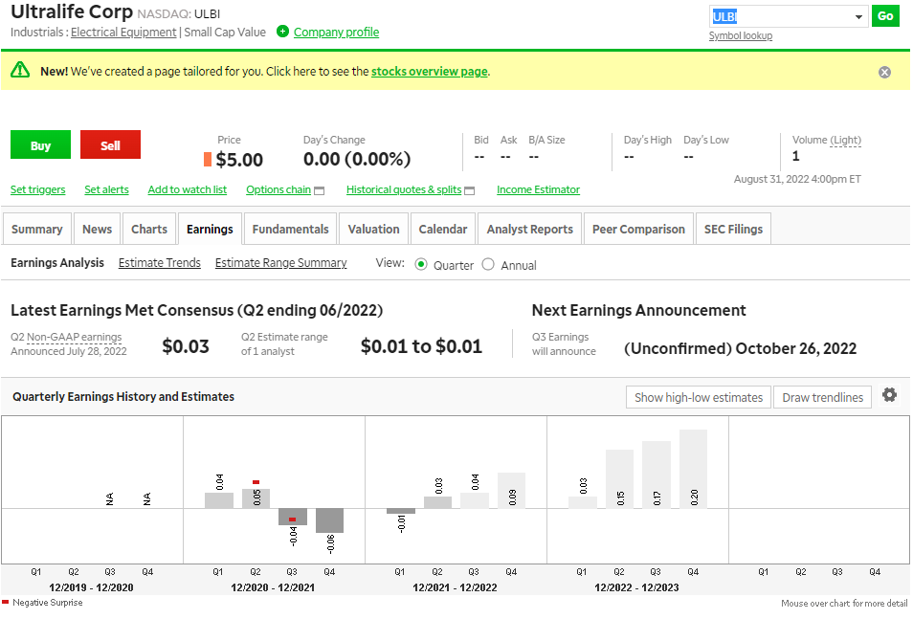
GAAP Trailing EPS: $0.032 + ($0.01) + ($0.07) + ($0.036) = ($0.084)
Adjusted Trailing EPS: $0.03 + ($0.01) + ($0.06) + ($0.04) = ($0.06)
Notes:
ULBI has been on earnings probation since the first quarter of 2022. If it has reported negative earnings for its latest quarter, it would have been removed. But since it reported positive earnings for its second quarter, it remains in the portfolio even those the trailing 12-month total is still negative.

Slide 36
Shadow Stock Portfolio Management Rules
Decisions are made at the end of the quarter once the earnings results have been announced
Typically, in late February, May, August & November
Use best judgment for mergers/tenders, but still follow rules
Best to focus on transaction costs
Give preference to stocks with lower bid/ask spreads

Slide 37
Shadow Stock Portfolio Management Rules
Sales proceeds > average position
Invest average portfolio position in qualified stocks
Excess cash held for future purchases
Sales proceeds < average position
Do not buy undersized position(s)
Hold proceeds in cash for future purchases
Notes:
Do not overload a single stock
Do not take under-weighted positions for the sake of adding new stocks
That is why it’s better to hold off selling a stock that has reached the valuation or size limit until there are replacements

Slide 38
Keep a Long-Term Perspective
Notes:
- Maintain reasonable expectations
- Market is reasonably efficient, but not in the academic sense that all information is instantaneously reflected in prices of all stocks. Nevertheless, information will eventually lead to stock price adjustments
Adjustments quicker for large caps than micro caps
- Micro-cap stocks tend to have consecutive periods of over-performance and then underperformance
- Micro-cap stocks have more volatility than large-cap stocks; important to maintain diversified portfolio and consider all asset classes and foreign markets as well as domestic markets

Slide 39
Keys to Shadow Stock Success
Time
Interest
Discipline
Minimize turnover
Notes:
- To succeed with the Shadow Stock approach:
- Need enough time to manage a stock portfolio
- Approach designed so that it only needs a careful examination quarterly, perhaps an 8-hour commitment
- If one has time, the portfolio can be reviewed monthly to keep up to date on earnings and company news
- Need an interest in managing a portfolio—in good times and bad
- Need discipline to follow the program once you have committed to it
Important to control turnover with micro-cap stocks
ANY QUESTIONS?

Slide 40
AAII Resources

Slide 41
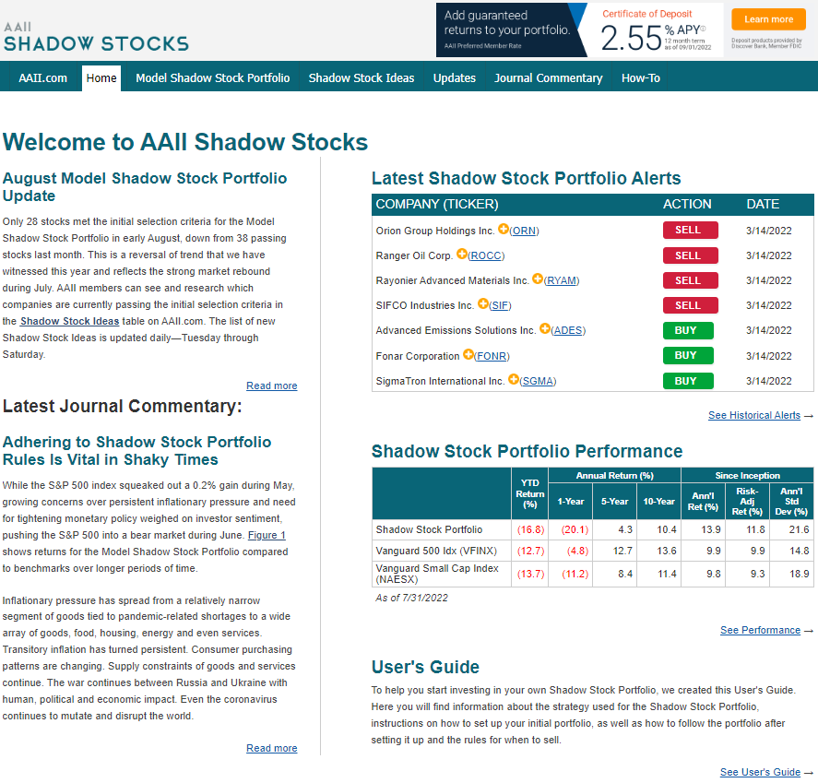
www.aaii.com/model-portfolios

Slide 42
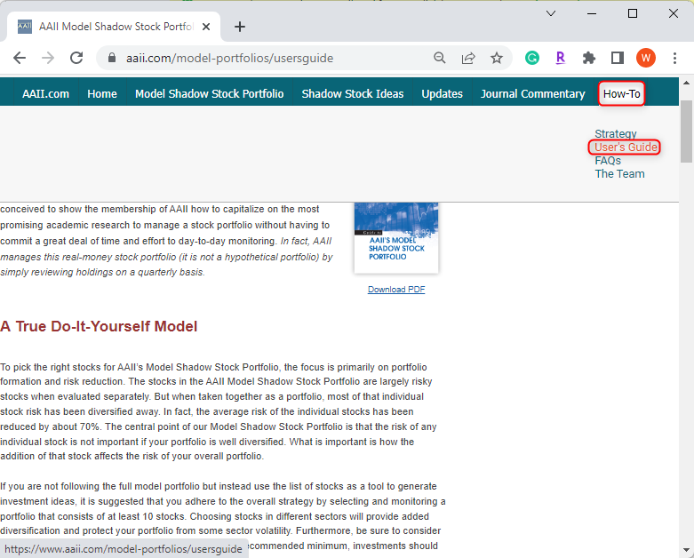
User’s Guide section has link to PDF version of latest Model Portfolio pamphlet or view as a web-based guide

Slide 43
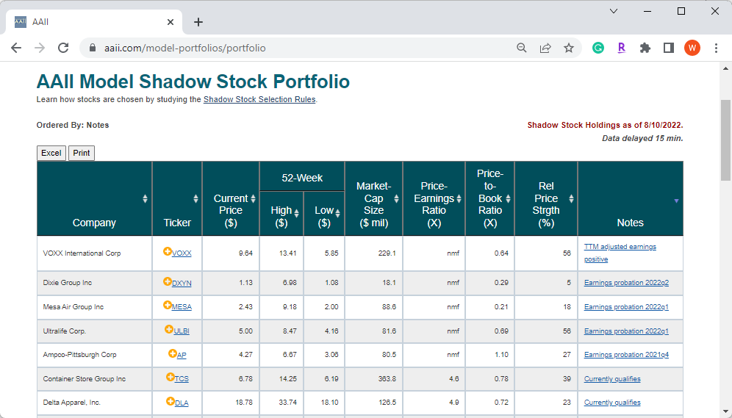
Actual AAII Model Shadow Stock Portfolio
Portfolio section updated monthly & lists current portfolio holdings
Current price-to-book ratio & market cap
Special notes (e.g., currently qualifies, earnings probation)
Pay attention to notes about current qualifiers, earnings probation, valuation & market cap

Slide 44
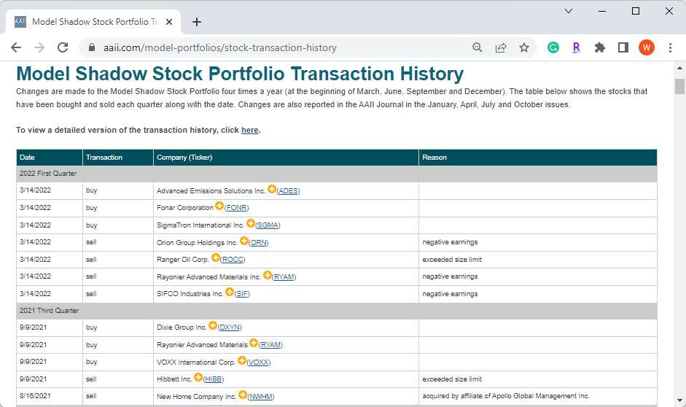
Transaction History page lists the Model Shadow Stock Portfolio transactions dating back to 2003

Slide 45
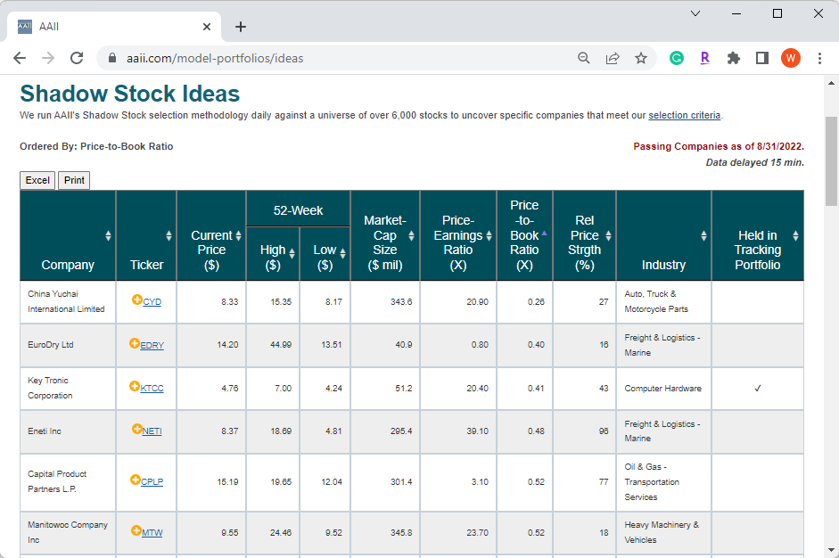
“Shadow Stock Ideas” list is updated daily and lists all stocks currently passing initial buy rules
You will need to monitor any stocks purchased from this list since they may not be part of our model portfolio

Slide 46
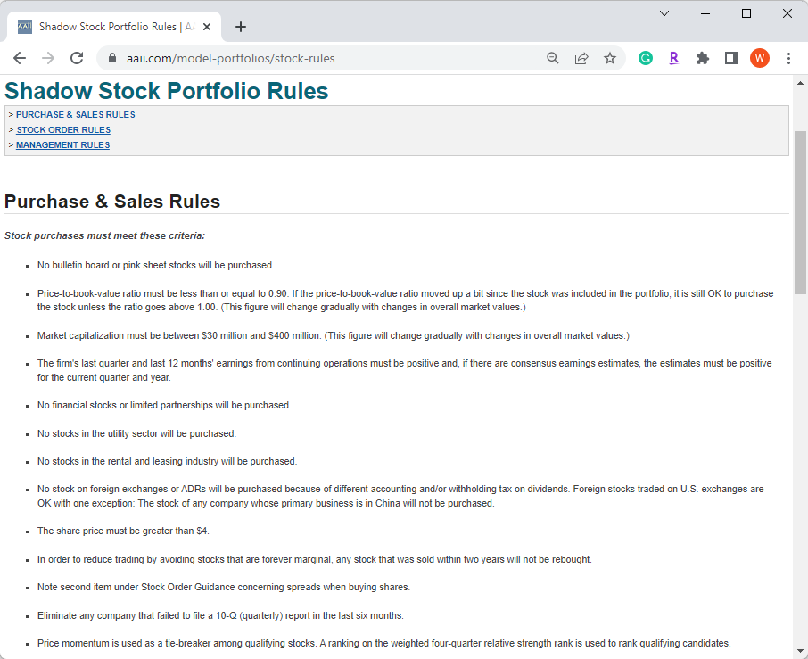
Current Model Shadow Stock Portfolio rules can always be found in this section
Rules are divided into sections dealing with initial buy criteria, sell criteria, guidelines for placing orders and overall portfolio management rules

Slide 47
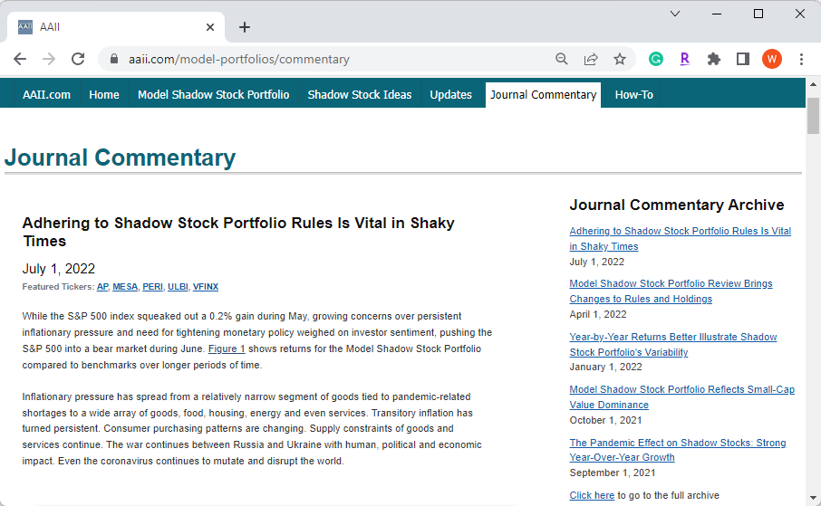
Past AAII Journal articles dealing with Model Shadow Stock Portfolios are presented in the “Journal Commentary” section
Helpful articles to gain an overview of the issues that come up in managing a micro-cap portfolio and how the rules evolve as market conditions change

Slide 48
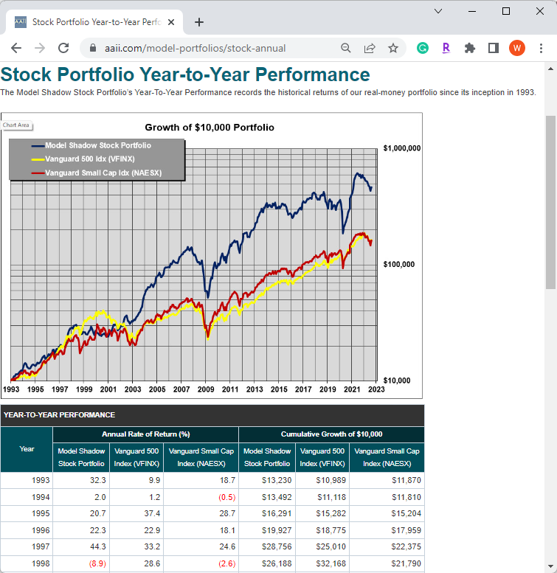
Year-to-Year Performance link brings up performance chart and table of annual performance

Slide 49
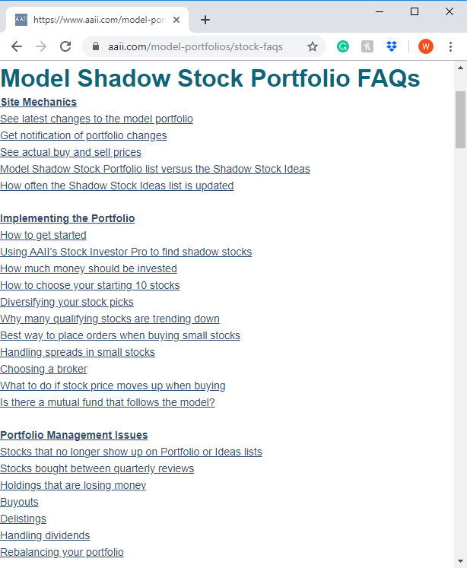
FAQs (Frequently Asked Questions)

Slide 50
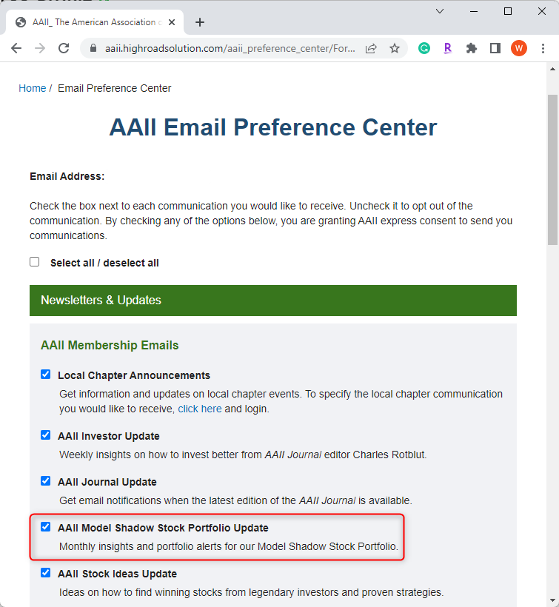
Members subscribing to the “AAII Model Shadow Stock Portfolio Update” receive a monthly email with the latest portfolio changes and current performance

Slide 51
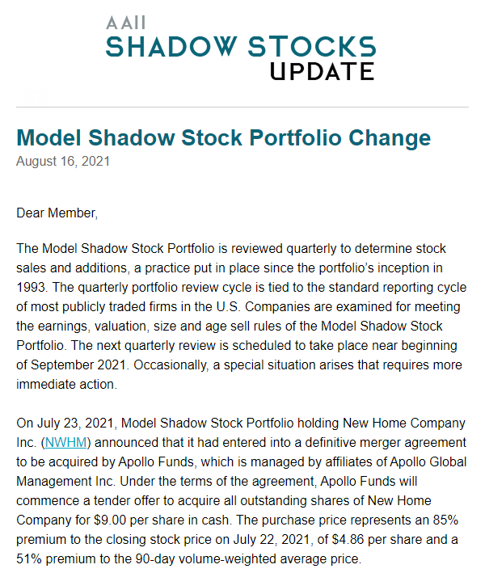
AAII Shadow Stocks Update Email

Slide 52
Stock Investor Pro
312-676-4307 - www.aaii.com/stock-investor-pro
Systems: Windows 8 and 10
Price: $299 a year
Daily data updates
System used by AAII to build and maintain Shadow Stock Portfolio
Includes Shadow Stock Screen (*IISSP) for performing initial screen
Has screening and analysis tools to monitor portfolio for quantitative sell process

Slide 53
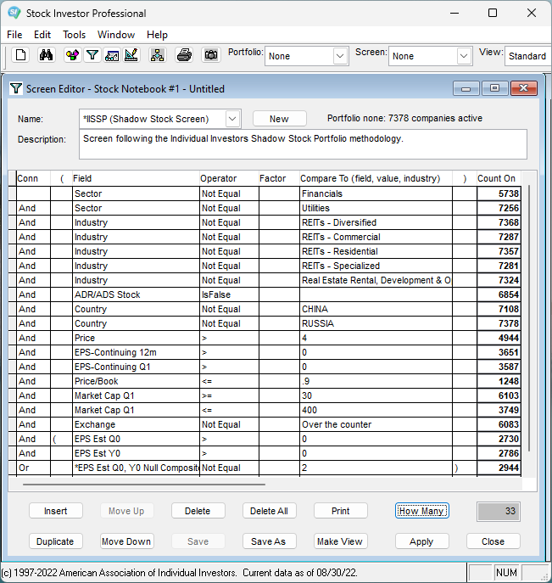
Stock Investor Pro
*IISSP (Individual Investor’s Shadow Stock Portfolio) screen is built into Stock Investor Pro

Slide 54
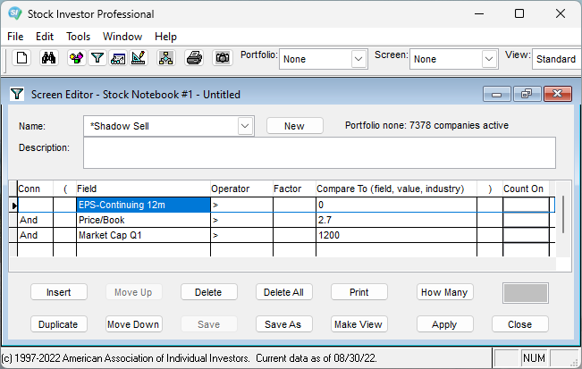
Stock Investor Pro
You can also create a sell screen that you can run against a portfolio of Shadow Stocks to see if there are any potential sell candidates
Notes:
Able to reverse the screen, however, and run it against of portfolio of existing Shadow Stocks to see if any are up for sale

Slide 55
Thank You!
Email your comments or questions to wayne@aaii.com

