Slide 1
Managing Risks in the Retirement Red Zone
Common Risks to Retirement Assets & Income
Richard Hill – Compass Financial Group
Notes:
The red zone refers to the last 20 yards before the end zone on a football field.
Offenses change their plays and defensive coaches change how they play defense when they get inside the red zone. Why? Because the stakes are higher and the nature of the game changes.
Like football coaches, investors approaching retirement should think about “changing their strategy” when they get near the goal line
Today we’re going to talk about income, and the threats to that income, when you move from accumulation to living off your assets in retirement.
For most of the game, the goal is to move the ball down the field and pick up 1st downs. When they get inside the red zone the objective changes – put points on the board.
During our working years, our goal is simply to grow our assets. In the retirement red zone, the objective changes – Income is the goal, followed by preservation and growth to keep pace with inflation.
Many of the risks we’ll talk about today aren’t a factor in our working years but become very important once we start generating income.
For example, before we retire we don’t have to worry about:
Running out of income as long as we are working
Taxes, since they are withheld from our income
Inflation - we usually receive COLA’s, so our income rises with inflation
In this workshop, I’ve identified 7 risks to your income that you need to be conscience of when designing a retirement income plan

Slide 2
Deck Instructions
This slide is hidden and will not show during presentations.
This deck can be used to showcase a protection story or an income story.
If being used to showcase a protection story, please hide slides 30, 31, 32, 42, 43, 44, 45, 46, and 47
If being used to showcase an income story (for use in the RIA and IMO channels), please hide slides 34, 35, 36, 37, 38, 39 and 40.
If being used with Edward Jones, please hide slide 30.
If not being used with Edward Jones, please hide slide 31.

Slide 3
Managing Risks in the Retirement Red Zone
Presented by:
Richard Hill
Compass Financial Group
919.714.7491 Office
www.richard.hill@compassfinancialgrp.com
www.compassfinancialgrp.com
Check out our website and blog or follow me on LinkedIn for information, tips and best practices to help you make the most of your retirement!
Securities & advisor services offered through LPL Financial, a Registered Investment Advisor, member FINRA/SIPC.
Prudential, Compass Financial Group and LPL are not affiliated.
SL 00096 11/2016
Notes:
Check out our website and follow us on LinkedIn for regular market updates, as well as tips, strategies and information to help you get the most out of your retirement.
Handing out a survey post meeting. Provide feedback, let me know what you would like to learn more about.
If you would like to be added to our email newsletter to hear about future workshops and get our tips & strategies in your inbox
Schedule a consult with us. Why:
You want to see if you are track to retire
Get guidance for all the decisions you will need to make (SS, roth conversions, tax-efficient income generation, healthcare, etc.)
Stress test your plan and portfolio to see if you have addressed the risks we are discussing today and create the best possible income strategy for you

Slide 4
What is The Retirement Red Zone?
Prudential has defined
The Retirement Red Zone
as the critical time period when you need a strategy for turning your assets into income that can last a lifetime.
Notes:
Read Slide

Slide 5
Managing Retirement Income Risks
Retirement Income Then and Now
Seven Risks to Retirement
Income
Managing Risk in Retirement
Notes:
Now, let’s review what we will cover today…our agenda…
READ SLIDE

Slide 6
Decline of the Defined Benefit Pension Plan
Defined Benefit and Defined Contribution Plans
(1983 vs. 2016)
Source: Center for Retirement Research; “401(k)/IRA Holdings in 2016: An Update from the Survey of Consumer Finances”; Munnell and Chen; October 2017, No. 17-18
Columns include participants with access to both plan types. The Survey of Consumer Finances is a tri-annual survey. Data from the 2019 Survey has not yet been released.
SL 00082 09/2020
Notes:
In the past, many of us could count on traditional, employer-funded, defined benefit pension plans to provide us with guaranteed income in retirement.
These plans provided a steady stream of income over the life of the retiree, and we transfer all the longevity and market risk associated with guaranteeing the payments.
These plans also typically include a survivor benefit. With this option, a surviving spouse continues to receive pension benefits after the retired worker’s death.
Today, pension plans have almost completely disappeared in the private sector. They have been replaced by defined contributions plans—401(k) plans, where the employee is responsible for doing most of the saving.
Of all employees that had access to a workplace retirement plan in 2016, only 27% had access to a defined benefit plan, down from 88% in 1983. You can see that the percentage with access to a defined contribution plan during that period jumped to 83% from 38%.

Slide 7
The Decline of Pensions
According to PBGC, the average single-employer Defined Benefit Plan is only 73% funded*
The average State Public Pension fund is only 40% funded**
Under the Budget Act of 2015, PBGC premiums increased:†
    Funded Plans: 40% between 2015 and 2019
    Unfunded Liabilities: 75% between 2015 and 2019
In 2018, 85% of companies asked were planning a divestment of pension obligations within the next 2 years, up from 43% one year earlier.‡
* PBGC Annual Pension Insurance Data Tables 2018, Table S-48; rev. 6-19-20; Single employer plans only; Weighted average underfunded pensions only. If overfunded plans are included 82.9%. Multi-employer plans Table M-13, 44.2%
** American Legislative Exchange Council; “Unaccountable and Unaffordable 2019: Unfunded Public Pension Liabilities Total Nearly $5 Trillion”; June 5, 2020. Average is an unweighted average.
† The Bipartisan Budget Act of 2015, Section 501;
‡ Ernst and Young; “How Can Divesting Fuel Your Future Growth? Global Corporate Divestment Study 2018;
SL 00082b 09/2020
Notes:
OPTIONAL SLIDE
Read Slide

Slide 8
Health of the Social Security System
$2.8
Trillion
  $981 Billion
  Added to Trust Fund in 2021‡
  $993 Billion
  in Benefits Paid in 2021‡
Trust Fund†
* The 2021 Annual Report of the Board of Trustees of the Federal Old-Age and Survivors Insurance and Federal Disability Trust Funds; Table IV.B3
† Trust fund balance at year end 2021
‡ Figures do not include DI trust fund; Funds added include OASI payroll tax revenue ($873 Billion), income taxes collected on benefits paid ($38 Billion) and interest on trust fund assets ($70 Billion).
SL 0013 08/2020
Notes:
For many of us, Social Security will be our only source of guaranteed income in retirement.
There has been a lot of discussion about the health of the Social Security system and how we can strengthen it.
[Read Slide]
Based on the current estimates, the combined Social Security/Disability Trust Fund will be exhausted in 2035. This means full benefits will no longer be paid. Receipts will be sufficient to pay 80% of scheduled benefits.

Slide 9
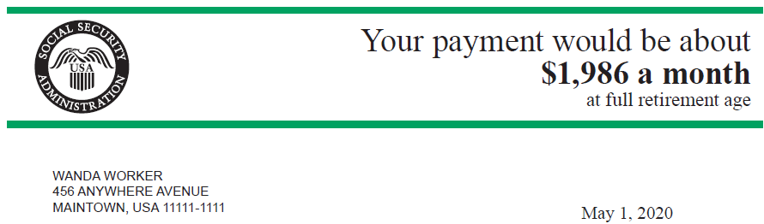
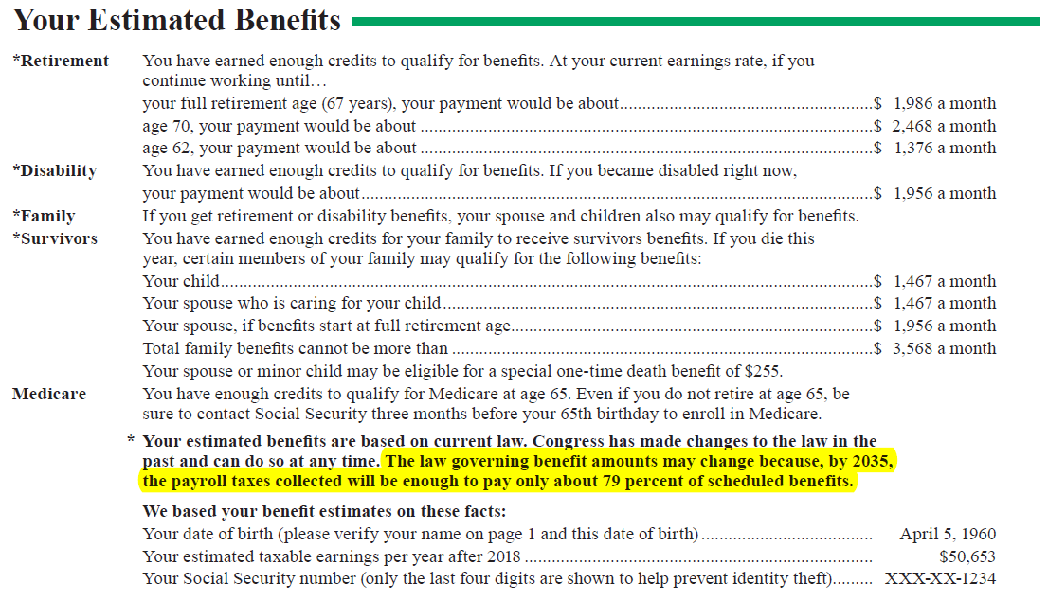
Future of Social Security
Proposed Changes
Higher Payroll Tax
Higher Taxable Wage Base
Higher Retirement Age
Means Testing
Recalculating COLA
Raise Earliest Eligibility Age
Base Benefits on Highest 40 years of Earnings
“Social Security benefits are not intended to be your only source of income when you retire. On average, Social Security will replace about 40 percent of your annual pre-retirement earnings. You will need other savings, investments, pensions, or retirement accounts to live comfortably when you retire.”
The law governing benefits may change because, by 2035, the payroll taxes collected will be enough to pay only about 80 percent of scheduled benefits.
Source: Form SSA-7005-SSM-SI.
SL 0014 08/2020
Notes:
As you think about retirement income, its important to understand the role SS will play in your plan
SS is the most valuable source of retirement income.
No other income source is as guaranteed, as tax efficient and as inflation proof as social security. As such, its important to maximize this income source when you retire.
This is what the Social Security Administration says about their own program on their statements:
CLICK]
[READ]
According to the 2020 Trustees Report, without changes, in 2035 the Combined Social Security and Disability Trust Funds (OASDI) will be able to pay only about 80 cents for each dollar of scheduled benefits.
This means that Congress will need to come up with a solution to address the issue soon.
Most likely the changes will be made to both the revenue and benefit sides of the equation.
On the revenue side, they will be considering increasing payroll takes increasing from today’s 6.2% and probably raising the taxable wage to more than the current $137,700.
On the benefit side, younger workers will likely see retirement ages increase.
Additionally, recipients could see changes to the way inflation COLA’s are calculated, resulting in smaller cost of living adjustments. We might even see means testing of benefit payments.

Slide 10
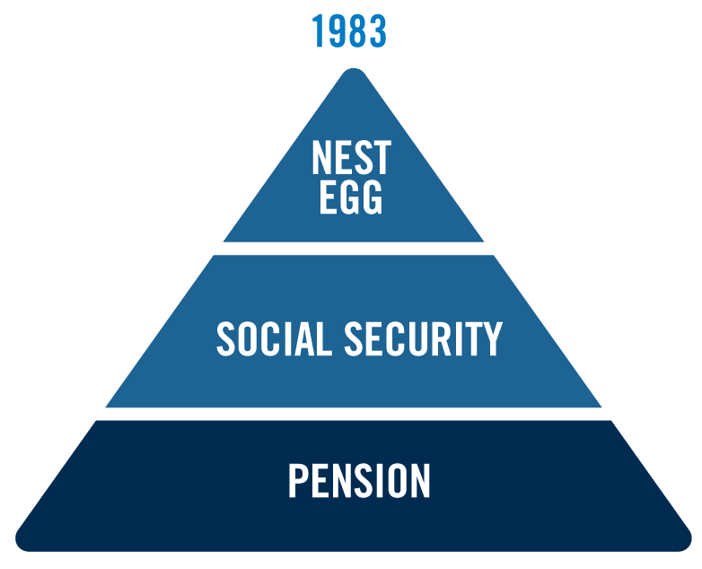
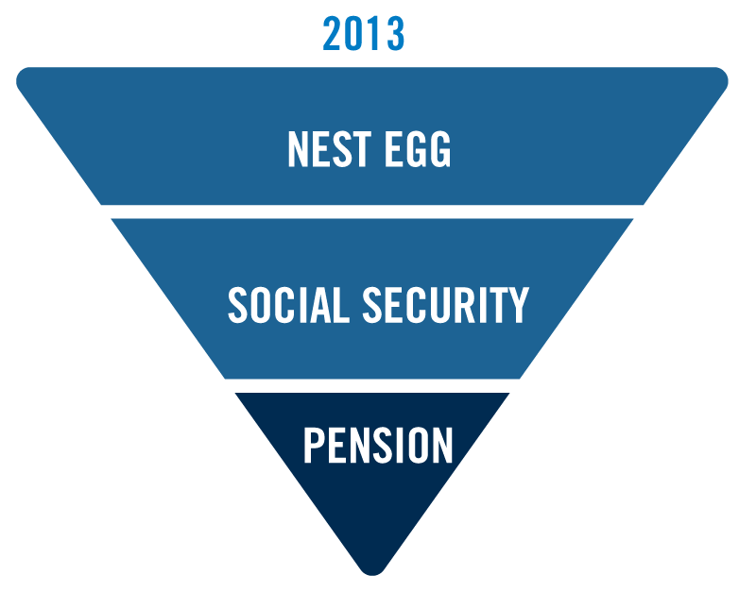
Retirement Income Then and Now
Then
Now
SL 0028 11/2016
Notes:
Pensions are playing a smaller role for Americans as they prepare for retirement. As a result of this, its become harder to generate steady income in retirement.
As you prepare for retirement, ask yourself these questions:
How important is it for me to have guaranteed income to cover my expenses?
What strategies are available to help increase Social Security benefits?
Other than Social Security, what guaranteed income sources are available?
As part of your retirement planning, its important to develop an income strategy. This could include taking dividends, selling shares, or other methods. All have their pros and cons and their proponents and naysayers
My philosophy – generate guaranteed income to cover fixed expenses and cover discretionary expenses with investment assets.
Guaranteed income can come from pensions, annuities, reverse mortgages or rental income.
Provides great peace of mind and a worry free retirement
Allows us to take more risk with the investment assets

Slide 11
Your Retirement is Your Responsibility
Common Risks to Retirement Assets
  Market Risk
  Sequence of Returns Risk
  Interest Rate Risk
  Investor Behavior Risk
  Inflation Risk
  Longevity Risk
  Withdrawal Rate Risk
Notes:
With the demise of pension plans and the uncertain future of Social Security, most Americans will now have the responsibility of creating their own retirement income strategy.
This isn’t as simple as it looks. For example, too many retirement income strategies rely on time value of money assumptions.
In other words, they assume a certain rate of return on their investments, an assumed rate of inflation and an assumed life expectancy.
It ignores the fact that markets fluctuate, inflation is not steady and life expectancy is unknown.
Lets address some of risk factors in retirement and plan accordingly.

Slide 12
1. Market Risks
What is a market correction?
– 10% loss from the most recent market peak
– 26 markets corrections since 1945
– 42% of corrections became bear markets*
1
What is a bear market?
– 20% loss from the most recent market peak*
– 11 bear markets since 1945*
2
What is the average bear market loss since 1945?
– 35%*
3
4
How many bear markets will a retiree face on average?
– 4 bear markets**
How long does the average bear market last?
– 17 months*
5
* JP Morgan “Guide to the Markets®, 4Q 2020; based on market activity post-WWII
** Assumes retiree age 65 with anticipated death at age 90, and an average 6.8 years between market peaks in the post-WWII era.
SL 00130d 02/2019
Notes:
This is the risk you may not be able to survive market corrections
Since 1945, there have been 26 market corrections of more than 10%. Almost ½ of those became bear markets
What is a bear market? 20% correction from most recent market peak. We hit bear market territory last week in the S&P 500
There have been 11 bear markets since WW II.
The average bear market lasts 17 months, with an average loss of 35%.
The average retired couple will experience 3-5 bear markets in their retired years
Assuming no withdrawals are taken from their retirement savings, it will take an investor 25 months to recoup those losses. Taking withdrawals will extend this.

Slide 13
Market Risk
Mathematics of loss in accumulation
100%
What percentage of gain does it take to recover from a loss?
42.86%
% of Gain Required to Break Even
25%
11.11%
5.26%
% Loss
5%
10%
20%
30%
50%
SL 0084 10/2018
Notes:
Let’s talk about the mathematics of loss. In a portfolio with no withdrawals, here is the return required to make up for certain losses.
This chart assumes a one-year decline from the initial value of an investment.
Read Slide
But what happens when you are taking withdrawals from your investments and you suffer a loss? Unfortunately, recovering to breakeven is even more difficult.
At a 4% withdrawal rate, the percentage of gain required over a 3-year period is much greater:
A 10% loss requires a 26% gain
A 20% loss requires a 42% gain
A 30% loss requires a 63% gain

Slide 14
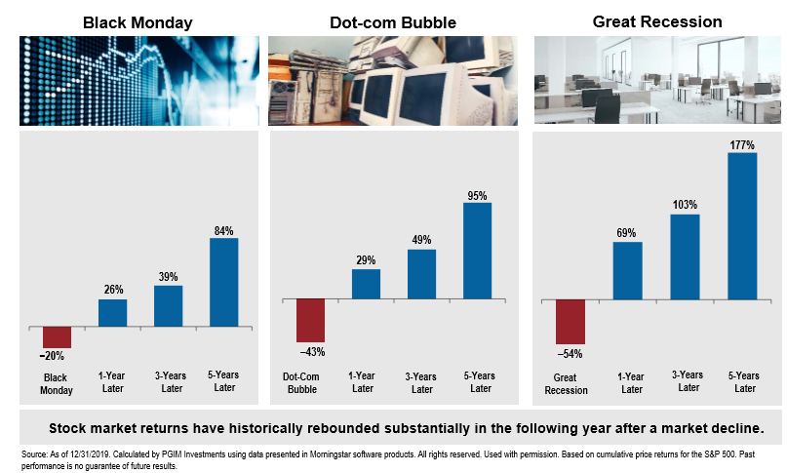
Stay the Course
Notes:
Read Slide
The stock market usually rebounds strongly in the immediately following a large market decline. Even at this rate of recovery however, it can take years to breakeven.
Being able to stay invested during this period is crucial and the breakeven is much shorter if we haven’t been selling to cover expenses during this period.
KEY QUESTIONS:
Does your retirement income strategy involve selling shares to generate income?
If so, will you be able to recovery from a significant market loss while exacerbating the problem by selling investments?
Does your strategy allow you to reduce income in poor market years to limit the damage?

Slide 15
2. Sequence Of Returns Risk
Accumulation
24%
18%
Client A: Down market initially
12%
14%
6%
8%
4%
Year | 1 | 2 | 3 | 4 | 5 | 6 | 7 | 8 | 9 | 10
-20%
-8%
-6%
$1,525,347
24%
18%
14%
12%
8%
$1,525,347
6%
4%
Year | 1 | 2 | 3 | 4 | 5 | 6 | 7 | 8 | 9 | 10
Client B: Down market at the end
-6%
-8%
-20%
For Illustration Purposes Only: $1,000,000 investment, and a 5.2% average rate of return
SL 0086 10/2018
Notes:
The risk that the timing of withdrawals from your investments may dramatically reduce your portfolio and impact the sustainability of future income
Sequence of Returns (Accumulation). On this slide we are looking at two Investors:
Investor A and Investor B both invest $1,000,000 in an accumulation portfolio made up of 50% stocks and 50% bonds.
Investor A:
Begins the 10 year period with the first 3 years of negative returns of -20%,-8%, and -6%
The following seven years are all positive returns (review slide).
At the end of 10 year period, Investor A’s total value of the portfolio is $1,525,347
That equates to a 5.1 average annual rate of return.
Now, let’s compare Investor B:
For investor B, we reversed the order of returns, with positive returns occurring early and the negative returns in years 8-9- 10.
You’ll see that the sequence of returns does not matter in an accumulation portfolio
Investor B’s portfolio value at the end of the 10-year period is the same as Investor A.
The both received a 5.1% average rate of return over the 10-year period.
Now lets look at how this same sequence of returns affects a retiree in a distribution portfolio.

Slide 16
Sequence Of Returns Risk
Distribution
$5,000 Annual Systematic Withdrawal
24%
18%
Client A: Down market initially
12%
14%
6%
8%
4%
Year | 1 | 2 | 3 | 4 | 5 | 6 | 7 | 8 | 9 | 10
-20%
-8%
-6%
$630,178
24%
18%
14%
12%
8%
$1,074,455
6%
4%
Year | 1 | 2 | 3 | 4 | 5 | 6 | 7 | 8 | 9 | 10
Client B: Down market at the end
-6%
-8%
-20%
For Illustration Purposes Only: $1,000,000 initial investment 5.2% average rate of return, $5,000 annual systematic withdrawal.
SL 0087 10/2018
Notes:
Sequence of Returns (Distribution): I want to illustrate the importance of sequence of return to retirees and just how misleading it is to use a historical average rate of return
In this slide, we are using the same sequence of returns but both Investor A and B are taking $5,000 annual systematic withdrawals from the portfolio.
Look at what happens:
Investor A, Again, we see the first 3-years with the same negative returns: -20, -8, and -6%.
Investor B: we see the negative returns in the last three years of the 10-year period.
For Investor A - the negative returns in the early years dramatically deteriorated the account value to approximately $630,178.
For Investor B - At the end of the 10-year period with the losses in years 8-9-10, the account has come down from its peak but still finishes with $1,074,455.
We all know that markets go down as well as up. For most investors, that’s not a problem --unless the down market happens to occur in the years just before or just after you retire.
Look at the difference negative returns early in retirement make. Just three years of negative returns early on could nearly halve the portfolio’s potential value by decade’s end.

Slide 17
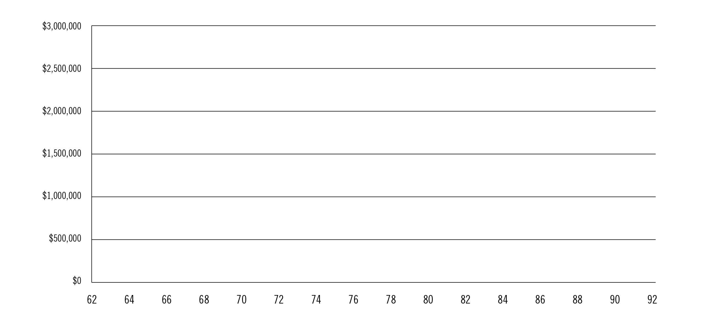
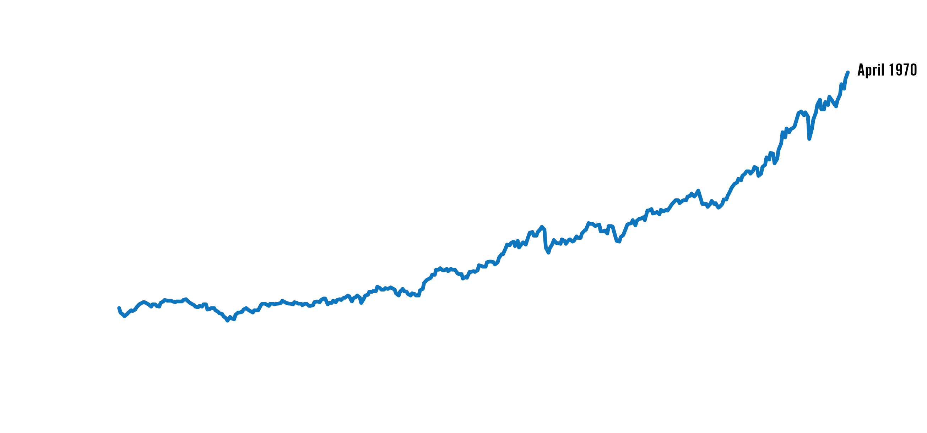
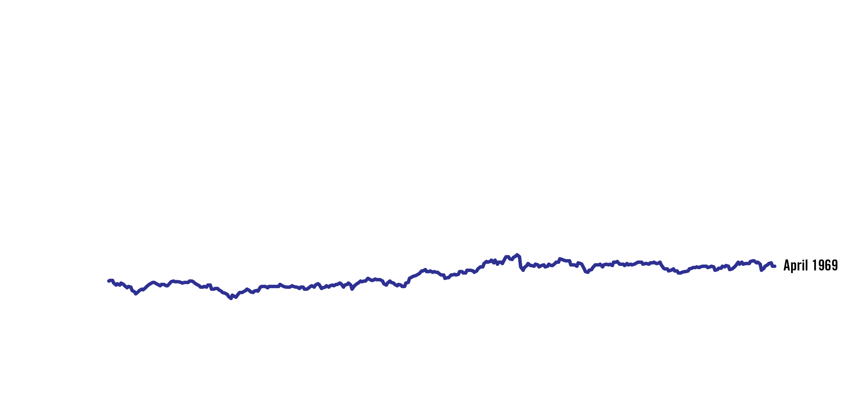
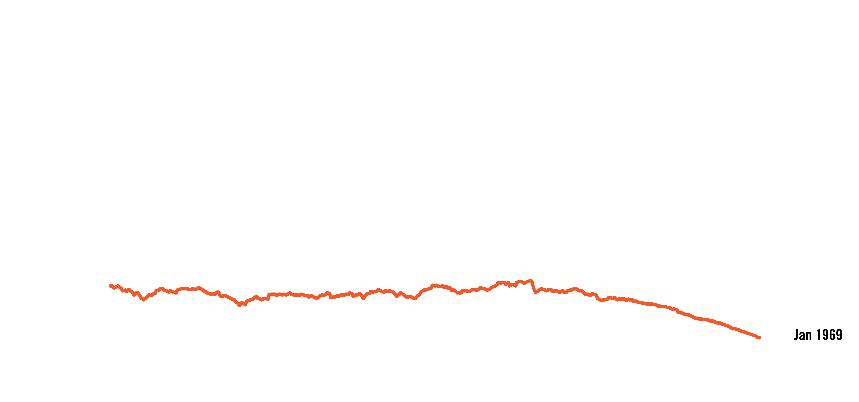
Sequence of Returns Risk
Timing is important
Value of portfolio over 30 years, taking 4.05% annually
Retirement in January 1969, April 1969 and April 1970
Investor’s Age
Chart assumes retirement at age 62
LIMRA Retirement Income Reference Book; LIMRA Secure Retirement Institute, October 2018; chart assumes $500,000 initial investment, 4.05% withdrawal adjusted annually for inflation; 42.5% Large Cap, 17.5% Small Cap, 40% Intermediate Government Bond, rebalanced annually
SL 00059 02/2019
Notes:
As we’ve seen, in the income phase of your life, the sequence of returns matters greatly. Its probably just as important or more important than average annual return on your portfolio.
Starting retirement when markets are doing well vs retiring when markets are doing poorly greatly increases the chances of a portfolio lasting through retirement.
Here’s a real world example:
Let’s take a look at a 30-year retirement beginning around 1970. This couple has $500k in a diversified portfolio (large cap, small cap, gov. bonds) rebalanced annually
Taking an initial distribution of 4.05% of the portfolio and adjusting annually for inflation.
How long this retirement account lasts can very much depend on when retirement begins.
If retirement distributions began at age 62 in April, 1970 - the retirement portfolio continues to grow and is greater than $1.5 million dollars at age 86.
If retirement distributions began a year earlier, in April 1969 - the portfolio value at the same age would only be about $600,000.
But, if distributions began just a few months before that, in January 1969 - the portfolio would be depleted by age 91.
KEY QUESTIONS:
Does your retirement income strategy involve selling shares to generate income?
Have you based your calculations on “avg returns”? Have you taken into account sequence of return risk?
If so, are you retiring into a rising or falling market?
Do you have a strategy in place to generate income from other sources if markets fall in the 5 year window around your retirement? (work, etc.)

Slide 18
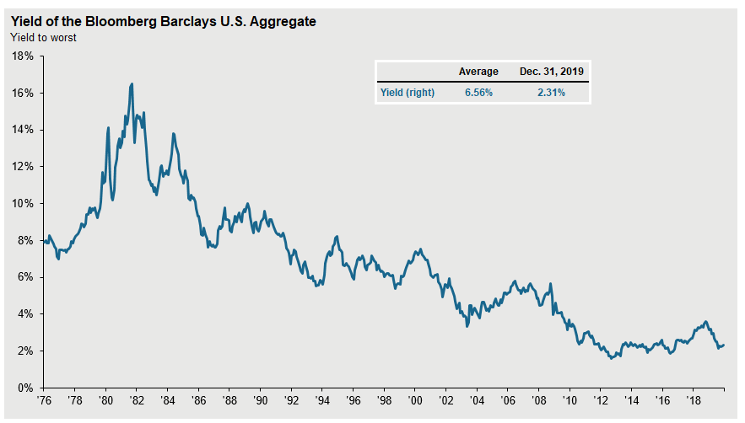
3. Interest Rate Risk
Over the last 35 years yields have continued to decrease
18
Notes:
The risk for potential investment losses or reduced income from changes in interest rates
Read Slide
Some people prefer to utilize bonds or interest bearing vehicles like CD’s to generate the income needed to cover their expenses.
This has become much more difficult as yields have fallen the past 40 years.

Slide 19
Low Interest Rates Impact in Retirement Income
Assumes $100,000 split equally into each fixed investment for every time period
$6,580 Income
86% pay cut
$4,680 Income
$920 Income
Source: U.S. Federal Reserve. All rates are market yield on US Treasury securities at 10-year constant maturity as of first trading day of the year
19
SL 0089a2 09/2020
Notes:
Read slide
Current yield on the 10 year has risen to about 3.25% as of 6/15
Highlights the inconsistency of yields over time and the difficulty generating substantial (and steady) income from bonds
KEY QUESTIONS:
Does your income strategy involve generating interest income from bonds, CD’s, etc.?
Will current yields allow you to earn enough income to cover the bills after taxes?
If you are drawing dividends from equities, can you budget monthly bills with quarterly distributions?
Are you prepared to reduce spending if interest rates fall?

Slide 20
4. Investor Behavior Risk
Source: Barclays, Bloomberg, FactSet, Standard & Poor’s, J.P. Morgan Asset Management; (Bottom) Dalbar Inc, MSCI, NAREIT, Russell.
Indices used are as follows: DM Equity: MSCI EAFE, Commodity: Bloomberg Commodity Index, High Yield: Bloomberg Barclays Global HY Index, Bonds: Bloomberg Barclays U.S. Aggregate Index, Homes: median sale price of existing single-family homes, Inflation: CPI. Average asset allocation investor return is based on an analysis by Dalbar Inc., which utilizes the net of aggregate mutual fund sales, redemptions and exchanges each month as a measure of investor behavior. Returns are annualized (and total return where applicable) and represent the 20-year period ending 12/31/19 to match Dalbar’s most recent analysis. Guide to the Markets – U.S. Data are as of September 30, 2020.
SL 0090 12/2020
Notes:
The risk that an investor will be reactive and risk averse, harming their long term returns
That is the reality of market results, but what about actual investor results?
Let’s quantify the effects for the average investor. The financial research firm Dalbar looked over a 20-year period, from 1999 to 2019:
High yield bonds actually outperformed equities over the past 20 years
The S&P 500 Index gained an average of 6.1%, stocks beat bonds, US stocks beat international equities and inflation ate away at our purchasing power.
However investor returns were dramatically less, coming in just above inflation at only 2.5%.
Dalbars study has been done for almost 40 years. Their results show that individual investors fall prey to market timing and performance chasing.
They often overreact to near-term events rather than relying on the strength of the market to perform over time.
They tend to buy high in times when the market is up and they sell low at times when the market is down. They do this out of emotion.
We have access to information in real time but don’t understand how to interpret it and what it means. We also lack the necessary discipline to capture the benefits of stock market investing over the long term.
Investment results are more dependent on investor behavior than on fund performance.
And there has been no shortage of market events that lead to this type of behavior.

Slide 21
Impact of Being Out of the Market
Yields are annualized over the 21-year period. Dollar values are final value of $10,000 at period end.
Source: Legg Mason. Past performance is no guarantee of future results. All investments involve risks, including loss of principal. The chart provided is for illustrative purposes only and represents an unmanaged index in which investors cannot directly invest. The data in the chart are based on 260 trading days in a year.
SL 00156 12/2020
Notes:
It’s a natural response for individuals to want to pull money out of the stock market in a downturn.
This can lead to a reduction in long-term returns however. When the market bounces back, it can happen suddenly and sharply.
Missing even a few trading days can cause us to miss some of the market’s biggest gains.
From the 20-year period from January 1, 1999 to December 31, 2019 there were 5,036 trading days… yet if an investor missed just the top 10 days that investors returns would be reduced by 50%.
This graph shows the average annual return in percentage and what $10,000 would be worth if fully invested, invested but missed the top 10 days, then top 20, and so forth.

Slide 22
Rewards of Long-Term Investing
Positive versus negative average annual returns for the S&P 500 (1937-2019)
63 years positive; 19.6% average positive return
20 years negative; -12.2% average negative return
20 years
2019: +31.5%
2013: +32.4%
2009: +26.5%
2003: +28.7%
1998: +28.6%
1997: +33.4%
1995: +37.6%
1991: +30.5%
1989: +31.7%
1985: +31.6%
1980: +32.4%
1975: +37.1%
1961: +26.9%
1958: +43.1%
1955: +31.4%
1954: +52.3%
1950: +31.5%
1945: +36.3%
1943: +25.6%
1938: +30.8%
16 years
2019: +31.5%
2013: +32.4%
2009: +26.5%
2003: +28.7%
1998: +28.6%
1997: +33.4%
1995: +37.6%
1991: +30.5%
1989: +31.7%
1985: +31.6%
1980: +32.4%
1975: +37.1%
1961: +26.9%
1958: +43.1%
1955: +31.4%
1954: +52.3%
1950: +31.5%
1945: +36.3%
1943: +25.6%
1938: +30.8%
2017: +21.8%
1999: +21.0%
1996: +23.0%
1986: +18.6%
1983: +22.5%
1982: +21.5%
1979: +18.4%
1976: +23.8%
1972: +19.0%
1967: +23.9%
1963: +22.8%
1952: +18.2%
1951: +24.0%
1949: +18.6%
1944: +19.5%
1942: +20.1%
2017: +21.8%
1999: +21.0%
1996: +23.0%
1986: +18.6%
1983: +22.5%
1982: +21.5%
1979: +18.4%
1976: +23.8%
1972: +19.0%
1967: +23.9%
1963: +22.8%
1952: +18.2%
1951: +24.0%
1949: +18.6%
1944: +19.5%
1942: +20.1%
10 years
9 years
2015: +1.4%
2011: +2.1%
2007: +5.5%
2005: +4.9%
1994: +1.3%
1987: +5.2%
1970: +3.9%
1960: +0.5%
1948: +5.4%
1947: +5.6%
8 years
2015: +1.4%
2011: +2.1%
2007: +5.5%
2005: +4.9%
1994: +1.3%
1987: +5.2%
1970: +3.9%
1960: +0.5%
1948: +5.4%
1947: +5.6%
2016: +12.0%
2004: +10.9%
1993: +10.1%
1992: +7.6%
1984: +6.2%
1978: +6.5%
1968: +11.0%
1959: +12.0%
1956: +6.5%
2016: +12.0%
2004: +10.9%
1993: +10.1%
1992: +7.6%
1984: +6.2%
1978: +6.5%
1968: +11.0%
1959: +12.0%
1956: +6.5%
2014: +13.7%
2012: +16.0%
2010: +15.1%
2006: +15.8%
1988: +16.6%
1971: +14.2%
1965: +12.5%
1964: +16.4%
2014: +13.7%
2012: +16.0%
2010: +15.1%
2006: +15.8%
1988: +16.6%
1971: +14.2%
1965: +12.5%
1964: +16.4%
Years up
0% - 6%
12.01% - 18%
18.01% - 24%
24.01%+
0% - 6%
6.01% - 12%
12.01% - 18%
18.01% - 24%
24.01%+
6.01% - 12%
2018: -4.4%
1990: -3.1%
1981: -4.9%
1953: -0.9%
1939: -0.4%
1973: -14.7%
2002: -22.1%
2018: -4.4%
1990: -3.1%
1981: -4.9%
1953: -0.9%
1939: -0.4%
2001: -11.9%
2000: -9.1%
1977: -7.2%
1969: -8.4%
1966: -10.0%
1962: -8.7%
1957: -10.7%
1946: -8.0%
1941: -11.6%
1940: -9.8%
1973: -14.7%
2002: -22.1%
2008: -37.0%
1974: -26.3%
1937: -34.7%
Years down
1 year
1 year
2008: -37.0%
1974: -26.3%
1937: -34.7%
3 years
5 years
10 years
Source: Legg Mason. Each calendar year listed in chart reflects average annual performance from December 31 of prior year to December 31 of listed year.
22
SL 00157 12/2020
Notes:
Though the returns of the stock market can vary from year to year, the average returns for the S&P 500 were positive for 76% of the 82 years shown (1937 – 2019).
The average annual return over these 82 years was 10.4%.
KEY QUESTIONS:
Do you have the temperament to stay invested in retirement when markets fall?
Are you in a financial position to stay invested in equities to benefit from the long term return potential of the stock market?

Slide 23
5. Inflation Risks
  Creates an increased income demand for the remainder of a retiree’s life.
  Can be most damaging in later years of retirement
  Average Annual Increase since 1982:
4.59%
2.82%
2.57%
CPI
CPI-Elderly
Healthcare
1. Source: US BLS; based on CPI-W from 12/1982 through 12/2019; http://data.bls.gov/timeseries/CWUR0000SA0?output_view=pct_1mth
2. Source: US BLS; CPI-E is an experimental index, public and unpublished data; 12/1982 through 12/2019
3. Source: US BLS; based on Medical Care index from 12/1982 through 12/2019: http://data.bls.gov/timeseries/CUUR0000SAM?output_view=pct_1mth
SL 0091 01/2020
Notes:
The risk that the future real value (after inflation) of an investment, asset, or income stream will be reduced by unanticipated inflation.
Read Slide
The CPI measures a basket of goods and services and the price change in these goods over the course of a year. These include food products, gasoline, clothing, medical care and housing
The CPI-Elderly is a measure of the increase in costs for a basket of goods and services that are more commonly used by the elderly.
It more heavily weights housing and healthcare, with less emphasis on gasoline, education and apparel.
With a roughly 3% inflation rate, the cost of living will double in 24 years. A person retiring on $70k at 65 will need approx. $140k in annual income at 89 to spend the same
KEY QUESTIONS
Have I taken inflation into account in determining whether my income will be sufficient 20 or 30 years from now?
Which of my income sources are subject to losing purchasing power from inflation?
Which of our income sources will allow for increases in income over time?
How will I respond if inflation is much greater than expected during my retirement?

Slide 24
6. Longevity Risks
Expected life span of individuals and couples age 65*
50% are expected to live to age:
25% are expected to live to age:
Men 88
Men 93
Women 90
Women 95
Couples (Surviving spouse) 93
Couples (surviving spouse) 98
51% chance one spouse will outlive the other by 10 years†
*Source: U.S. 2012 IAM Period Table, Society of Actuaries
† LIMRA Retirement Income Reference Book; LIMRA Secure Retirement Institute; October 2018
SL 0005 03/2020
Notes:
The risk that retirees will live long enough that they will deplete their retirement savings
One of the issues that married couples need to deal with is longevity.
If you are a relatively healthy 65-year old couple, there is a 50% chance that one of you will live to age 93. That’s almost 30 years. How do you ensure you are able to generate rising income for this period?
FOR WOMEN:
More than two-thirds of American age 85 or older are women.
Eight out of 10 centenarians are women.
50% of women will live past 90, 25% of women will live past 95. Half of women over age 65 will outlive their husband by 15 years
KEY QUESTIONS
Will the income to the surviving spouse be sufficient to continue their lifestyle?
Do we have pensions or annuities that may only pay out over one lifetime?
Can we maximize guaranteed income sources now to ensure the surviving spouse is protected? (SS at age 70 for primary breadwinner?)

Slide 25
7. Withdrawal Rate Risk
What is a Safe and Sustainable Withdrawal Rate?
[Not for use with Edward Jones]
  The rate one can safely withdraw from their retirement portfolio without prematurely depleting the account
  Opinions on Safe Withdrawal Rates have varied over time
Bengen (1994)¹: | 4%
Guyton (2004)²: | 3.6% - 5.8%
Milevsky & Huang (2010)³: | 3%
Pfau (2020)⁴: | 2.1%
1. “Determining Withdrawal Rates Using Historical Data”, William Bengen, Journal of Financial Planning, October 1994
2. “Decision Rules and Portfolio Management for Retirees: Is the ‘Safe’ Initial Withdrawal Rate Too Safe?”, Jonathan Guyton; FPA Journal; October 2004
3. “Spending Retirement on Planet Vulcan: The Impact of Longevity Risk Aversion on Optimal Withdrawal Rates”; M.A. Milevsky & H. Huang; Retirement Income Journal, March 2010
4. “Retirement Income Dashboard For a Benchmark Couple Both Turning 65 in July 2020”; Conservative portfolio (25% stock allocation) with 2% spending COLA; Wade Pfau at https://retirementresearcher.com/dashboard/
SL 0092 09/2020
Notes:
The risk that retirees will withdraw too much (or too little) and deplete their assets
Withdrawing too much causes obvious problems. Withdrawing too little due to fear about running out of money can cause retirees to unnecessarily limit their spending and lifestyle
In order to determine if you are in position to retire, you will need to make some assumptions about how much you can safely withdraw from investments each year.
There has been a long debate about the amount you can safely withdraw from your portfolio so it lasts for the rest of your life
In theory, a safe withdrawal rate is the maximum amount of money you can withdraw from a retirement portfolio with zero probability of depleting these savings during your lifetime.
Also referred to as a “Sustainable Withdrawal Rate.”
As you can see, over time, financial experts have had different opinions on what a safe withdrawal rate is, depending on the current market conditions.
In the past, a safe withdrawal rate has been viewed as being as high as almost 6%.
In today’s low interest rate environment, the latest estimates are actually lower than 3%.
This may change again as bond yields increase over time

Slide 26
30 Year Retirement
Likelihood of Success
Withdrawal Rate¹ |  | Stock/Bond Mix
 |  | 100/0 | 80/20 | 60/40 | 40/60 | 20/80
3% |  | 97% | 98% | 99% | 99% | 99%
4% |  | 85% | 87% | 90% | 89% | 85%
5% |  | 69% | 69% | 66% | 57% | 43%
6% |  | 52% | 49% | 41% | 26% | 10%
7% |  | 38% | 30% | 21% | 7% | 1%
8% |  | 25% | 17% | 7% | 1% | 0%
1. Assumes withdrawal is increased 3% annually for inflation.
Source: T. Rowe Price 2020. Analysis of 30 year period. IMPORTANT: The information regarding the likelihood of various investment outcomes is hypothetical in nature, does not reflect actual investment results, and is not a guarantee of future results. The simulations are based on a number of assumptions. There can be no assurance that the results shown will be achieved or sustained. The charts present only a range of possible outcomes. Results may vary, and such results may be better or worse than the simulated scenarios. Clients should be aware that the potential for loss (or gain) may be greater than demonstrated in the simulations.
*Calculations only considered stock/bond mixes; short-term bonds were not included.
The probabilities shown are the likelihood of having at least $1 remaining in the portfolio at the end of the retirement period.
SL 00141 06/2020
Notes:
T. Rowe Price did some research of their own on this topic and tried to help investors identify the optimal stock to bond mix for their retirement portfolio.
As you can see, there is no one right solution for everybody. Generally speaking, the higher the withdrawal rate the higher the allocation should be to stocks.
While this chart shows the PERCENTAGE of times that success (or failure) occurred, it does not show the MAGNITUDE of the results.
In portfolios with higher allocations to equities, the failures were often far more severe than in cases where the investor had a large allocation to bonds.
Read Slide

Slide 27
RMDs and Sustainable Withdrawals
RMDs Increase Each Year*
Age
70½†
3.6%
72†
3.9%
75
4.4%
80
5.4%
85
6.8%
90
8.8%
*If the spouse is the sole beneficiary and is more than 10 years younger, the RMD distribution rate is lower.at each age
† IRA owners who attained age 70½ prior to 1/1/2020 have a Required Beginning Date of age 70½. IRA owners who attained age 70½ after 12/31/2019 have a Required Beginning Date of age 72
SL 00006 01/2020
Notes:
As we think about safe withdrawal rate, we need to consider the RMDs we will be forced to take at age 72
According to the IRS tables, at age 72 those with IRAs and 401(k)s will need to withdraw a minimum of 3.9% of the value of the IRA.
As you can see, the withdrawal quickly increases and very quickly exceeds what is considered a sustainable withdrawal rates.

Slide 28
Managing Retirement Risks
Transferring Risk Can Help
    Manage the impact of volatility on retirement savings
    Provide opportunities for growth of retirement assets while hedging downside risk
    Increase the probability of a successful retirement
    Minimize the stress that comes from volatility and market corrections
Managing Risks
A
Avoid
Retain
Transfer
R
T
SL 00101b 12/2020
Notes:
There are different ways to manage retirement risks.
Try to Avoid it as much as possible.
Some do this by simply getting out of equities and investing in money market funds, CDs and Treasuries that are “low-risk” and offer security of principal.
However, the cost of principal security is the risk that portfolio returns will be low, jeopardizing your financial goals and subjecting one to inflation risk.
Acceptable option if assets or guaranteed income is great enough that no growth is required
Retain it.
Investors who neither avoid nor transfer risk end up retaining risk and must manage their investment portfolios carefully.
These retirees are subject to Market Risk, Sequence of Returns Risk, Interest Rate Risk, and the other risks we discussed.
Investors who retain risk usually end up using investments such as equities, longer duration bonds or even alternative investments to generate the growth & income needed to cover expenses.
This strategy can work but there will be risk to capital and no guarantees. Poor luck, unexpected market corrections, higher than planned inflation can disrupt the plan.
[Click:]
Transfer as much as possible.
It is possible to reduce your by transferring some of it to those better able to handle it.
Each of us are different. You know your personality. In this strategy, you would work with your financial professional to identity risks of greatest concern and try to transfer them.
Some risk can be offloaded for no cost:
Taking SS at 70 to transfer longevity risk to the Fed. Gov.
In some cases, there will be a fee associated with this risk transfer:
Using a reverse mortgage or annuity to provide additional guaranteed income (fees to insurance company and/or mortgage company)
However, by transferring risk, an investor may achieve higher returns than are possible by avoiding risk, and with less volatility than if the risk was retained.
Covering fixed expenses with guaranteed income sources may allow you to take more risk in your investment portfolio, with the possibility of higher returns, without worrying about market or sequence of return risk
Although we have clients that utilize all three approaches, the one that seems to provide the greatest peace of mind to our clients (any the one I recommend) is to transfer risk when possible.

Slide 29
Indexed Variable Annuities
Protection with growth opportunity
Cap & Buffer Strategy
  Outcomes
  Down Market:
Index value declines less than buffer, client does not experience loss.
Index value declines more than buffer, client will be credited the index return resulting in a loss of value.
  Outcomes
  Up Market:
Index value grows less than Cap, client is credited 100% of Index return.
Index value grows more than Cap, client will be credited up to the Cap.
B
A
A
B
$143,512
$135,562
Year 1
Year 2
Year 3
Year 4
Year 5
Year 6
Year 7
Year 8
Year 9
Year 10
Growth Model Index
Indexed-linked variable annuity products are complex insurance and investment vehicles.
The chart above is for illustrative purposes only. It assumes a starting account value of $100,000 in a Growth oriented index-based strategy with a 10% Buffer and an 11% cap with a 1-year term, and that no withdrawals were taken. The example does not reflect a specific annuity or an actual account value. Returns assume no reinvestment of dividends. Assumes no withdrawals and that the Account was held for the complete Index Strategy Term. The actual cap rate may be higher or lower than the cap rate shown. Different index-based strategies, as well as different time periods, may have different cap rates and produce different results
Flexible premium deferred index-linked variable annuity contracts are complex insurance and investment vehicles which possess the risk for substantial loss of principal.
SL 00158 12/2020
Notes:
[Optional slide for use in the protection version of the deck only]
Let’s discuss how the typical index-linked variable annuity works. This is an illustration of the typical cap and buffer strategy. Most index-linked variable annuities are going to offer caps with a buffer. There are four outcomes in this strategy: [click]
In an up market, if the index value grows less than the cap, the account is credited 100% of the gains at the end of the term. If the index value grows more than the cap, the account is credited 100% up to that performance cap, this is the same method as in fixed indexed annuities. [click]
Where it differs from FIAs is in down markets. Whereas FIAs provides 100% downside protection, with an index-linked variable annuity with a buffer, when the index value declines less than the buffer the client does not experience a loss. However, if the index value declines more than the buffer, the insurance company covers the loss up to the buffer, the account will be credited negative performance for losses beyond the buffer.
In this example you will notice that the account value outside of the index-linked variable annuity was just over $143,500. The index-linked variable annuity return $135,500. Cap strategies do create a ceiling when the index performs well. Some of the new innovations that we will talk about offer 100% participation strategies, even strategies that have the opportunity to outperform the index.

Slide 30
Important Information
Annual Returns and Crediting Table
End of Year | Year 1 | Year 2 | Year 3 | Year 4 | Year 5 | Year 6 | Year 7 | Year 8 | Year 9 | Year 10
Growth Model Index | 3.00% | 13.62% | 3.53% | -38.49% | 23.45% | 12.78% | 0.00% | 13.41% | 15.60% | 5.50%
Index Credited | 3.00% | 11.00% | 3.53% | -28.49% | 11.00% | 11.00% | 0.00% | 11.00% | 11.00% | 5.50%
Minimum Credited | 0.00% | 0.00% | 0.00% | 0.00% | 0.00% | 0.00% | 0.00% | 0.00% | 0.00% | 0.00%
The table above is for illustrative purposes only. It assumes a starting account value of $100,000 in a Growth Model index-based strategy with a 10% Buffer at an 11% cap with a 1-year term, and that no withdrawals were taken. The example does not reflect a specific annuity or an actual account value. Returns assume no reinvestment of dividends. Assumes no withdrawals and that the Account was held for the complete Index Strategy Term. The actual cap may be higher or lower than the cap shown. Different index-based strategies, as well as different time periods, may have different caps and produce different results. Any withdrawals taken from either scenario during the surrender period will reduce the account value, and surrender charges and an MVA will apply.
This information refers to the previous slide.
30
SL 00160b 12/2020
Notes:
[Optional slide for use in the protection version of the deck only]
Read slide.

Slide 31
Indexed Variable Annuities
Various Strategies
Point to Point Cap Rate Strategy
 | Term | Cap Rate | Buffer
S&P 500 | 1 year | 17% | 10%
S&P 500 | 3 year | Uncapped | 10%
S&P 500 | 6 year | Uncapped | 20%
Step Rate Strategy
 | Term | Step Rate | Participation Rate | Buffer
S&P 500 | 1 year | 8% | 90% | 5%
Accelerated Participation Rate Strategy
 | Term | Tier Level | Tier 1 Rate | Tier 2 Rate | Buffer
S&P 500 | 6 year | 20% | 100% | 130% | 10%
Hypothetical example of an Indexed Variable Annuity illustrating some of the different cap rate and buffer strategies typically offered by these products.
SL 00160c 12/2020
Notes:
[Optional slide for use in the protection version of the deck only]
Index variable annuities offer various strategies for investors. Some of these strategies include [Read Slide].
This slide does not list all of the strategies available on current indexed variable annuities, meaning these products offer a lot of options for clients to consider when determining which strategy aligns to their goals.

Slide 32
Market Index Movements
Frequency of gains and losses of the S&P 500® over 30 years
  April 1990 – March 2020
 | S&P 500®
 | 1-Year | 3-Year | 6-Year
Average Return | 9.0% | 29.9% | 65.2%
# of Gains | 277 | 256 | 246
# of Losses | 72 | 69 | 43
Index loss less than or equal to 5% | 20 | 9 | 18
Index loss between 5%-10% | 11 | 6 | 14
Index loss between 10%-20% | 19 | 14 | 11
Index loss greater than 20% | 22 | 40 | 0
All periods mentioned above are rolling monthly periods. Past performance is not a guarantee of future results. For illustrative purposes only. This data does not represent the performance of any specific investment. Indexed accounts are tied to market performance, but they are not actual investments in the stock market. Source: Performance information provided by Bloomberg.
SL 00160d 12/2020
Notes:
[Optional slide for use in the protection version of the deck only]
Read Slide

Slide 33
Over the Last 30 Years with the S&P 500
1 Year Term Strategy
85% of the time a 5% buffer
would have protected against
a market loss in a 1-year term
In a Positive Market,
53% of the Time
the S&P 500 was up
more than 10%
88% of the time a 10% buffer
would have protected against
a market loss in a 1-year term
Source: Performance information provided by Bloomberg. April 1990- March 2020. Past performance is not a guarantee of future results.
SL 00160e 12/2020
Notes:
[Optional slide for use in the protection version of the deck only]
Read Slide

Slide 34
Potential Markets for Indexed Variable Annuity
Clients who are nervous about market volatility
Clients in the “retirement redzone”
Clients heavily invested in cash
IRAs and Roth IRAs
Trusts
Charitable organizations and non-profits
SL 00160f 12/2020
Notes:
[Optional slide for use in the protection version of the deck only]
Read Slide

Slide 35
Bucketing Strategy
Protected Strategy Can Help Manage:
Market Risk
Sequence of Return Risk
Investor Behavior Risk
11+ Year Horizon
Higher Risk
Higher Equity Portfolio
6-10 Year Horizon
Moderate Risk
Protected Strategy
1-5 Year Horizon
Low Risk
CDs, treasuries, money market
…and can be leveraged to protect a portion of a client’s portfolio.
SL 00161 12/2020
Notes:
Read Slide

Slide 36
Retirement Income Planning Example
Guaranteed Sources of Income
(Pension, Social Security, Annuities, Rental Estate, Reverse Mortgages)
Cover Essentials
Essential Monthly Expenses
(Housing, Food, Clothing, Healthcare, Insurance, Utilities)
Cover Gap
Consider Converting Assets into Cash Flow
Other Sources of Income
(Mutual Funds, Stocks, Bonds, CDs,)
Discretionary Expenses
(Travel, Cars, Restaurants, Entertainment, Home Improvements)
Discretionary
SL 00110 11/2018
Notes:
As you prepare for retirement, it might be helpful to think about categorizing your income sources as well as your expenses.
Once you understand what your fixed expenses are vs. your discretionary expenses, you can work to ensure you are covering the essentials with guaranteed income
Read slide

Slide 37
Covering Essential Costs
Essential Expenses $57,000
  Housing/Food/Clothing/Transportation $46,000
  Healthcare $11,000
Guaranteed Income Sources $37,000
  Pension $15,000
  Social Security $22,000
Income Gap to Cover Essential Expenses ($20,000)
SL 0070-20 10/2018
Notes:
Read Slide

Slide 38
Converting Assets to Cash Flow
Investment needed to generate $20,000/year at age 65
Non-guaranteed investment with 3.50% withdrawal
$571,429
Funding Fixed Annuity at age 65
$392,157
31% Less
Funding Fixed Annuity at age 60
$337,695
41% Less
46% Less
Funding Fixed Annuity at age 55
$309,717
$0 | $150,000 | $300,000 | $450,000 | $600,000
These hypothetical examples assume income percentages of 5.1% at age 65, 4.6% at age 60, 4.1% at age 55, and an income growth rate of 5.75%, and all are for illustrative purposes only. They do not reflect a specific annuity, an actual account value or the performance of any investment, please refer to the following slide for additional information.
SL 0071F-20k-3.5 12/2020
Notes:
In our example, we need to cover an annual income gap of $20,000. Let's look at different investments that could potentially generate that $20,000.
[Click.] If you put your retirement savings in a non-guaranteed investment and withdraw 3.50% annually, you would need to invest $571,429.
But that's not guaranteed income, and as we discussed earlier, 3.5% may not be a safe withdrawal rate.
[Click.] Investing in a fixed annuity, you'll be able to do more with less -- at age 65 you'll need to invest [$392,157] to generate $20,000/year.
[Click.] If you invest in a fixed annuity at age 60, you'll only need a little more than [$337,000]
[Click.] And if you invest in a fixed annuity at age 55, you'll need just [$309,717] to generate an income stream of $20,000/year.
As interest rates rise, annuities become more attractive as their payouts are based on market interest rates.
Non-guaranteed withdrawal rate of 3.5% reflects a married couple age 65 with a moderate risk tolerance (50/50 equity /fixed income allocation with expectation that wealth in year 30 will be at least 15% of wealth in initial year), a 2% COLA and 5 years of buffer assets (for example, cash value life insurance or home equity line of credit). Source: “Retirement Income Dashboard For a Benchmark Couple Both Turning 65 in July 2020”; Moderate portfolio ;Wade Pfau at https://retirementresearcher.com/dashboard/

Slide 39
Creating Lifetime Income
$1,000,000 to invest for retirement at Age 67
$1,000,000
X
4.0%
=
$40,000
Invested in equity
and bond investments
Annual
withdrawal rate
Annual income, not guaranteed, affected by market swings
How does adding a guaranteed income option change the picture?
This is a hypothetical example for illustrative purposes only.
SL 00102 11/2019
Notes:
Let’s say you have $1,000,000 in assets and a need for immediate income of $40,000 per year to supplement your other sources of retirement income.
One option would be to allocate the entire $1,000,000 into a portfolio of equities and bonds, and take a 4% annual withdrawal to create the $40,000 per year of income she needs.
This strategy may work fine, but remember the income would not be guaranteed and would be susceptible to the ups and downs of the market.
Another option would be to split the difference and transfer some of the risk while maintaining the rest.

Slide 40
Reducing Withdrawal Rates from
Non-Guaranteed Investments
Retirement Portfolio of $1,000,000
A two-part investment strategy
PART ONE
PART TWO
$500,000
Fixed Annuity
$500,000
Other Investments
$26,000
Guaranteed income for life
$14,000
2.80% withdrawal rate
Over 99% probability of success*
These hypothetical examples assume income percentages of 5.2% at age 67 and withdrawal rate of 2.80% and are for illustrative purposes only. A fixed annuity is suitable for long-term investing, particularly when saving for retirement; however it is possible to lose money investing in securities.
* Based on T. Rowe Price study cited on slide [42], assuming a 3% annual withdrawal and an allocation of 60% stocks and 40% bonds. Success defined as having at least $1 remaining in the portfolio at the end of the retirement period. Assumes withdrawal is increased 3% annually for inflation.
SL 0072 10/2021
Notes:
Part 1 – take $500,000 and allocate it to an annuity contract with a [5.2%] payout rate. This would generate [$26,000] annually.
Now you only need to generate [$14,000] annually from the remainder of the portfolio.
Part 2 – Invest the remaining $500,000 in a portfolio of equities and bonds to generate the remainder of the needed cash flow.
Total cash flow is now $40,000. Since you are only withdrawing [2.80%] of the portfolio the likelihood is great you will be able to sustain you income through retirement.
This allocation also increases your income flexibility. You could increase the withdrawal rate on the non-annuity portfolio to 4%, increasing your cash flow $40,000 to [$46,000] a [15%] increase.
You can also take on more investment risk in the portfolio, potentially earning a higher rate of return
This two-part strategy creates a more efficient retirement portfolio because the guaranteed income helps take the pressure off the portfolio.

Slide 41
Incorporating Annuities in Planning
  Transfers Some Risks to Insurance Company
  Increased Portfolio Longevity
  Improved Probability of Success
  Takes Pressure off Other Assets
  Frees Up Other Assets to Invest More Aggressively
  Protection during Market Downturns
  Manages volatility by hedging against downside risk
  Potentially Increased Retirement Income
Notes:
Read Slide

Slide 42
Summary
  Be careful of retirement income strategies that rely on basic time value of money assumptions
  Develop an income strategy based on your income needs, assets, risk tolerance and personality
  Ensure your planning addresses the seven risks to retirement income
  Consider covering fixed expenses with guaranteed income
  When possible, consider transferring risks you don’t want to ignore or retain

Slide 43
Disclosures
Investors should consider the features of the contract and the underlying portfolios' investment objectives, policies, management, risks, charges and expenses carefully before investing. This and other important information is contained in the prospectus, which can be obtained by contacting the National Sales Desk. Clients should read the prospectus carefully before investing.
Annuities are issued by Pruco Life Insurance Company (in New York, by Pruco Life Insurance Company of New Jersey), located in Newark, NJ (main office). Variable annuities are distributed by Prudential Annuities Distributors, Inc., Shelton, CT. All are Prudential Financial companies and each is solely responsible for its own financial condition and contractual obligations. Prudential Annuities is a business of Prudential Financial, Inc.
This material is being provided for informational or educational purposes only and does not take into account the investment objectives or financial situation of any clients or prospective clients. The information is not intended as investment advice and is not a recommendation about managing or investing a client’s retirement savings. Clients seeking information regarding their particular investment needs should contact a financial professional.
Prudential Annuities and its distributors and representatives do not provide tax, accounting, or legal advice. Please have your clients consult their own attorney or accountant.​
All references to guarantees are backed by the claims-paying ability of the issuing company and do not apply to the underlying investment options.
© 2021 Prudential Financial, Inc. and its related entities. Prudential Annuities, Prudential, the Prudential logo, and the Rock symbol if applicable are service marks of Prudential Financial, Inc. and its related entities, registered in many jurisdictions worldwide.

Slide 44
Disclosures
Bloomberg Barclays U.S. Aggregate Bond Index covers the USD-denominated, investment grade, fixed rate, taxable bond market of SEC-registered securities. The index includes bonds from the Treasury, Government-Related, Corporate, Mortgage-Backed Security (MBS), Asset-Backed Security (ABS) and Commercial Mortgage-Backed Security (CMBS) sectors.
MSCI EAFE (Europe, Australasia, Far East) is a widely accepted benchmark for international stock performance. It is a free float-adjusted market capitalization index that is designed to measure the equity market performance of 21 developed markets, excluding the U.S. and Canada.
S&P 500® Index is a market capitalization-weighted index of the 500 widely held stocks often used as a proxy for the stock market. S&P chooses the member companies for the 500 based on market size, liquidity and industry group representation.
Withdrawals and distributions of taxable annuities are subject to ordinary income tax and, if made prior to age 59½, may be subject to an additional 10% federal income tax penalty, sometimes referred to as an additional income tax. Withdrawals reduce the Account Value. Withdrawals taken during the surrender charge period, excluding any Required Minimum Distributions (RMDs) may be subject to any applicable surrender charges and a Market Value Adjustment (MVA).
Withdrawals in excess of the income amount impact the value of a product or benefit and can also affect the certainty of the income. An excess withdrawal occurs when cumulative Lifetime Withdrawals exceed the income amount in an annuity year. If an excess withdrawal is taken, only the portion of the Lifetime Withdrawal that exceeds the remaining income amount for that year will proportionally and permanently reduce future guaranteed amounts. If an excess withdrawal reduces the account value to zero, no further amount would be payable and the contract terminates.
Fixed income investments are subject to risk, including credit and interest rate risk. Because of these risks, a subaccount’s share value may fluctuate. If interest rates rise, bond prices usually decline. If interest rates decline, bond prices usually increase.

Slide 45
Disclosures
Diversification does not ensure against loss in a declining market.
The value or price of a particular stock or other equity or equity-related security owned by a portfolio could go down and you could lose money.
Fixed indexed annuities are not FDIC-insured; they also have limitations and surrender charges.
It is not possible to invest directly in an index.
Equity Securities Risk – The value of a particular stock or equity-related security held by a Portfolio could fluctuate, perhaps greatly, in response to a number of factors, such as changes in the issuer’s financial condition or the value of the equity markets or a sector of those markets. Such events may result in losses to the Portfolio.
Investments in real estate investment trusts (REITs) and real estate-linked derivative instruments are subject to risks similar to those associated with direct ownership of real estate. Poor performance by the manager of the REIT and adverse changes to or inability to qualify with favorable tax laws will adversely affect the Portfolio. In addition, some REITs have limited diversification because they invest in a limited number of properties, a narrow geographic area, or a single type of property.
Investment in fixed income securities involves a variety of risks, including that: an issuer or guarantor of a security will be unable to pay obligations when due; due to decreases in liquidity, the Portfolio may be unable to sell its securities holdings at the price it values the security or at any price; and the Portfolio’s investment may decrease in value when interest rates rise. Volatility in interest rates and in fixed income markets may increase the risk that the Portfolio’s investment in fixed income securities will go down in value. Risks associated with rising interest rates are currently heightened because interest rates in the U.S. are at or near historic lows but may be expected to increase in the future with unpredictable effects on the markets and the Portfolio's investments.

Slide 46
[Firm Disclosures]

