Slide 1
Income Investing for Second Half 2020 and Beyond
August 2020
Roger S. Conrad
Capitalist Times LLC

Slide 2
Briefing Objectives
Roadmap: Income Investing in 2H 2020
Dividend Safety: Name of the Game
Sector Discussion: Utilities, Energy, REITs
Best Buys for income, safety and long-term capital growth
What’s new at CT
Your Turn

Slide 3
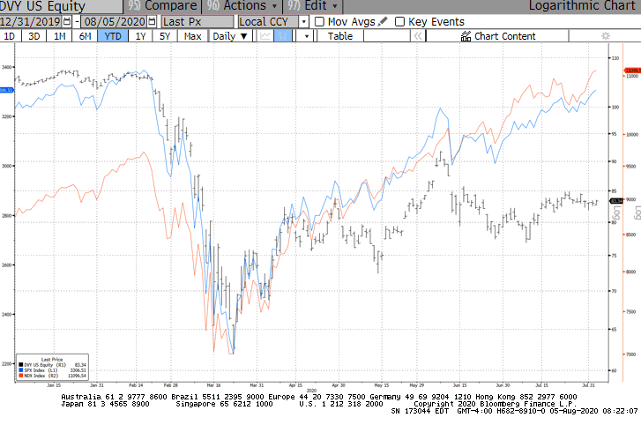
Dividend Stocks Lag

Slide 4
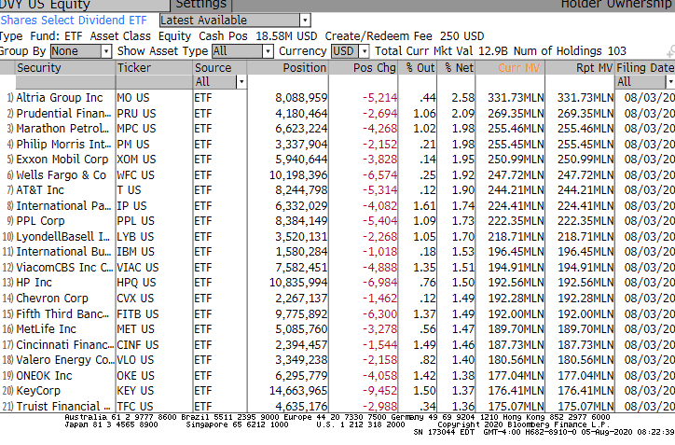
Lagging is Broad Based

Slide 5
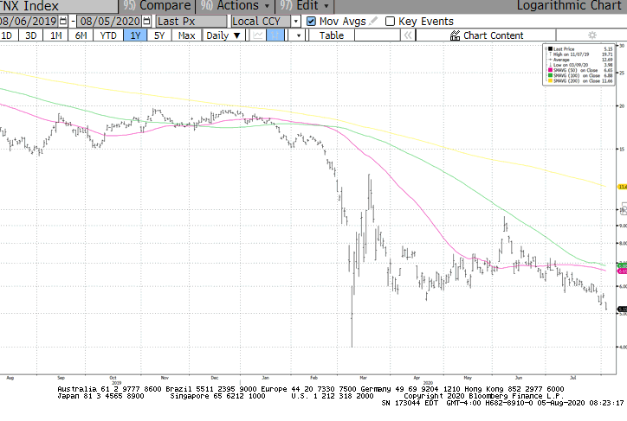
Interest Rates: How Low?
TNX

Slide 6
Dividend Stocks Follow the Economy
Year | S5TELS | DJUA | BBREIT | ALERIAN MLP | S&P 500 | TNX
2020 | 6.7 | -3.8 | -10.3 | -35.5 | 3.4 | -73.2
2019 | 32.7 | 27.3 | 27.7 | 6.3 | 31.5 | -28.6
2018 | -12.5 | 2.0 | -4.6 | -12.4 | -4.4 | 11.7
2017 | -1.3 | 13.3 | 9.0 | -6.5 | 21.8 | -1.7
2016 | 23.4 | 18.2 | 9.0 | 18.3 | 12.0 | 7.8
2015 | 3.4 | -3.1 | 3.2 | -32.6 | 1.4 | 4.6
2014 | 3.0 | 30.7 | 29.1 | 4.8 | 13.7 | -28.2
2013 | 11.5 | 12.7 | 2.4 | 27.6 | 32.3 | 72.3
2012 | 18.3 | 1.6 | 18.6 | 4.4 | 16.0 | -6.1
2011 | 6.6 | 19.7 | 8.1 | 13.9 | 2.1 | -43.4
2010 | 19.0 | 6.5 | 29.5 | 35.6 | 15.1 | -14.0
2009 | 8.9 | 12.5 | 29.2 | 75.7 | 26.5 | 71.3
2008 | -30.5 | -27.8 | -37.9 | -37.1 | -37.0 | -44.4

Slide 7
Market Indicators: Value
Value has collapsed since last month and failed to participate in the SPX bounce

Slide 8
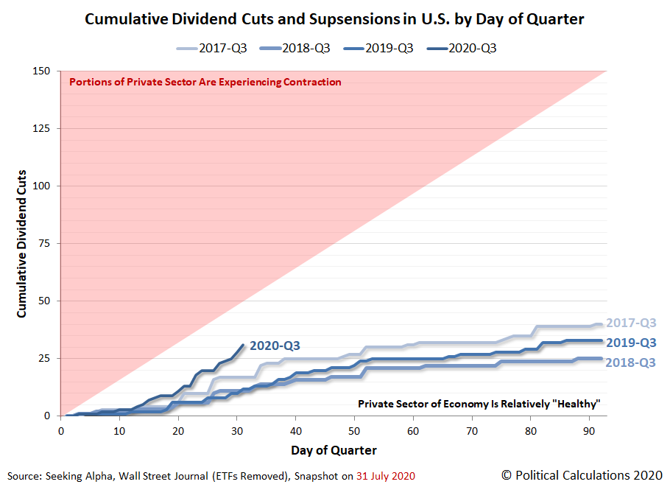

Slide 9
Dividend Safety: Name of the Game
Elevated Risk
Low Risk
Energy
Hospitality
Shopping Mall REITs
Most Financials
High Yield Telecoms
Regulated Utilities
Large Pharma
Large Communications
Highest Quality REITs
Big Tech

Slide 10
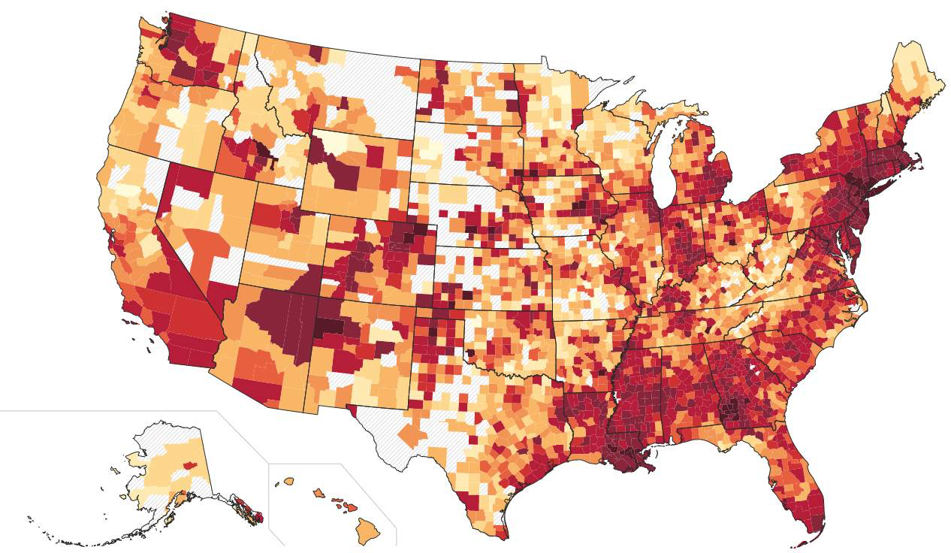
Covid-19 Strikes South

Slide 11
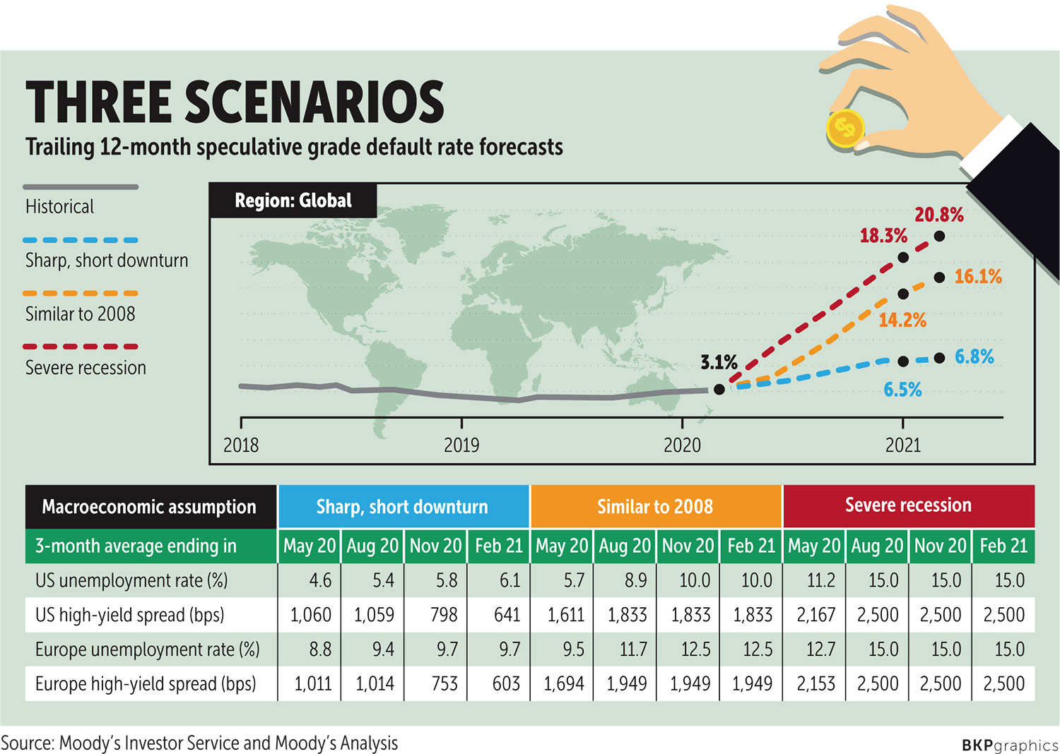
The Perils of (Over) Leverage
Defaults in 2007-09

Slide 12
Take the Quality Test
Dividend policy sustainability
Revenue reliability
Regulatory/Legal concerns
Balance Sheet—Refinancing risks are critical despite very low borrowing rates
Operating Efficiency—Ability to squeeze costs out of the business is critical at a time of uncertain sales growth

Slide 13
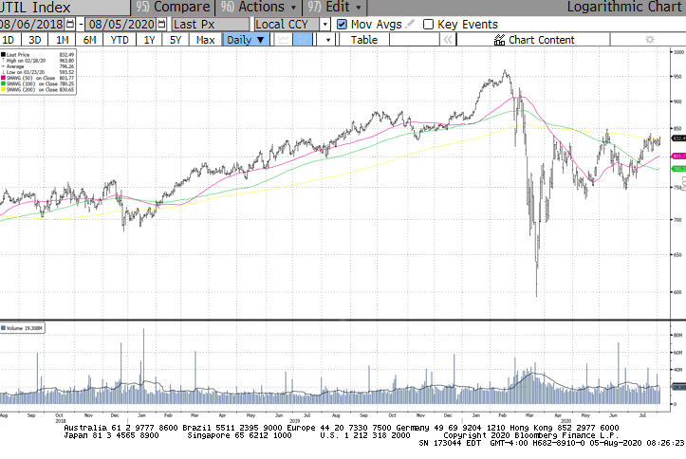
Regulated Utilities: Proving Resilience
UTIL

Slide 14
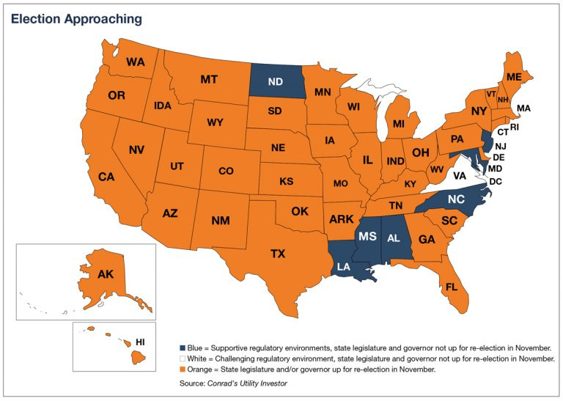

Slide 15
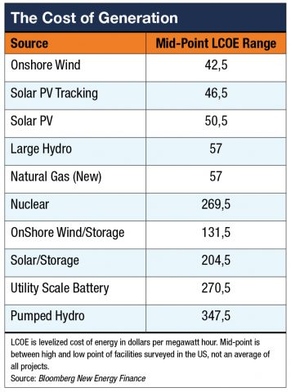
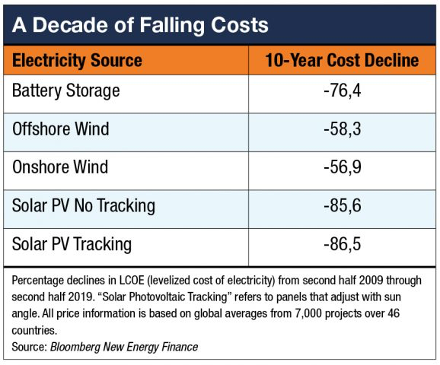
Renewables: A Driver More than Ever
Pic of renewables growth, falling prices

Slide 16
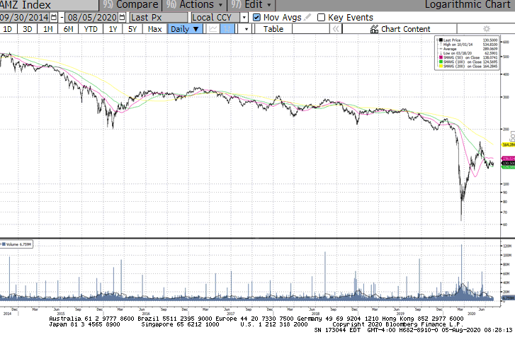
Energy: What’s Next?

Slide 17
Energy Stocks: Not all the Same
Look for Companies With
Avoid Companies With
Strong Balance Sheets
Low Cost of Debt Capital
Contracts that rely on fees not volumes
Limited direct commodity price exposure/low costs
Room to cut costs
Diversified Assets by function/geography
Heavy leverage
Small size—limited reach
Contracts that rely on volumes
Need at least $50 per barrel oil to be profitable
Rely heavily on a single customer or region
Rely on a few assets

Slide 18
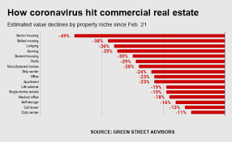
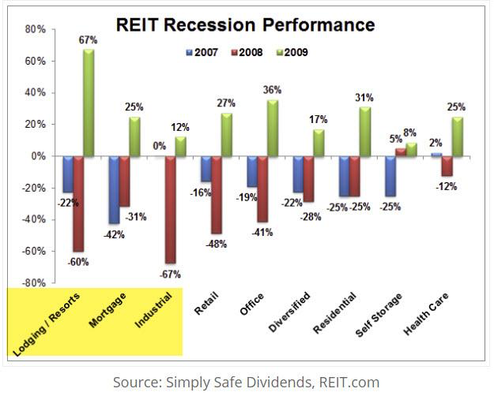
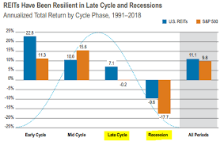
REITs Follow Growth

Slide 19
REIT Investing Outlook
Pandemic’s impact on rent collection is the critical factor this year
Q2 worse than Q1, 2H TBD
Impact on businesses using REIT model varies widely—not reflected in ETFs
Balance sheet strength is single most important factor for weathering crisis
Property quality and strength of tenants also key but largely TBD
Valuations are lowest for many retail, office and apartment REITs in many years

Slide 20
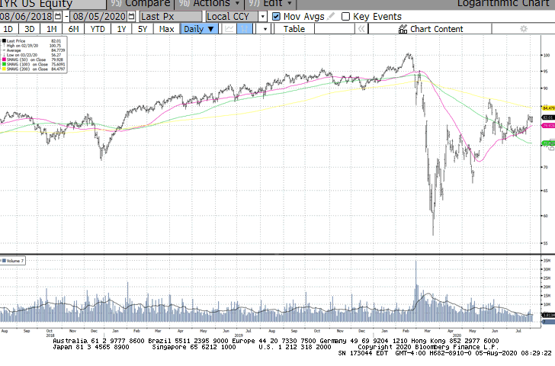
REITs Rebound

Slide 21
REIT Sheet
At Lower Risk to Covid-19
At Elevated Risk
Telecom infrastructure
Data centers
Medical research
Renewable energy BDCs
High quality residential
High quality office properties
Established Canadian REITs
Single tenant
Retail—particularly shopping malls
Hospitality
Retirement communities
Down market properties
Cyclical diversified—energy related etc
Most M-REITs
Single tenant

Slide 22
Keeping it Simple
Keep cool, stay conservative and take what the market gives you
Focus your buying power on stocks
Keep some cash handy
Sell companies weakening on the inside to get out in front of possible dividend cuts
Take profits when warranted
Adjust entry points where earned

Slide 23
Managed Income Portfolio
Company (Symbol) | Initial Entry | Price | Shares | Dividends | $ Profit/Loss | % Profit/Loss | Advice
ABB (NYSE: ABB) | 2019-04-16 | 24.99 | 300 | 463.11 | 1990.11 | 33.34 | Buy<22
Abbvie (NYSE: ABBV) | 2020-03-10 | 94.91 | 50 | 118.00 | 588.50 | 13.77 | Buy<95
Arrow Financial (NSDQ: AROW) | 2018-11-30 | 27.30 | 206 | 292.24 | -675.96 | -10.25 | Buy<32
BHP Group (NYSE: BHP) | 2018-12-19 | 52.84 | 150 | 670.00 | 1957.00 | 29.48 | Buy<55
Blackrock Utils & Infra (NYSE: BUI) | 2019-01-25 | 21.24 | 300 | 677.60 | 916.60 | 14.95 | Buy<23
Brookfield Prop (NYSE: BPY) | 2018-09-25 | 11.19 | 300 | 526.50 | -2210.50 | -36.27 | Buy<15
Cisco Systems (NSDQ: CSCO) | 2020-07-13 | 47.10 | 100 | 0.00 | 50.00 | 1.07 | Buy<52
Clearway En (NYSE: CWEN) | 2018-09-25 | 24.54 | 350 | 472.85 | 2402.35 | 36.07 | Buy<22
CVS (NYSE: CVS) | 2019-09-22 | 62.94 | 50 | 100.00 | 144.50 | 4.66 | Buy<72
Dominion Energy (NYSE: D) | 2018-09-25 | 81.03 | 100 | 455.00 | 1603.00 | 23.05 | Buy<85
Kraft Heinz (NYSE: KHC) | 2020-07-22 | 34.38 | 150 | 0.00 | -18.00 | -0.35 | Buy<35
Texas Instr (NYSE: TXN) | 2019-03-04 | 127.55 | 50 | 417.70 | 1470.20 | 27.61 | Buy<120
Total SA (NYSE: TOT) | 2019-11-11 | 37.66 | 200 | 313.10 | -1124.90 | -12.54 | Buy<45
Vanguard Fed Money (VMFXX) | 2020-03-22 | 1.00 | 7240 | 87.44 | 87.44 | 1.21 | Buy<1
Vanguard Int Tax-Ex (VWITX) | 2018-09-21 | 14.77 | 1442.8877 | 1599.72 | 6701.17 | 41.34 | Buy<14.60

Slide 24
Looking Ahead
Constant Vigilance: Market is moving higher now but there’s much uncertainty
Earnings reporting season not bad as feared…but what’s ahead?
Goal #1 is to avoid big and permanent hits to capital.
Goal #2 is to add positions in great, dividend paying investments at the lowest possible prices

Slide 25
CT Services
CUI Plus
Conrad’s Utility Investor
Deep Dive Investing
Energy and Income Advisor
Pig Versus Bear
12 Stocks
The REIT Sheet
Creating Wealth

Slide 26
YOUR TURN
CALL SHERRY: 1-877-302-0749 9-5 ET, M-F
SERVICE@CAPITALISTTIMES.COM

